Slide 1
Database 2 project
TELCO
Blasucci Camilla - 10640601
Buono Salvatore - 10600540

Slide 2
Index
Specification
Conceptual (ER) and logical data models
Trigger design and code
ORM relationship design with explanations
Entities code
Interface diagrams or functional analysis of the specifications
List of components
UML sequence diagrams (optional, only for salient events)

Slide 3
Specification
USER APPLICATION
From the Home page, the user can access a Buy Service page for purchasing a service package and thus creating a service subscription. The Buy Service page contains a form for purchasing a service package. The form allows the user to select one package from the list of available ones and choose the validity period duration and the optional products to buy together with the chosen service. The form also allows the user to select the start date of his/her subscription. After choosing the service packages, the validity period and (0 or more) optional products, the user can press a CONFIRM button. The application displays a CONFIRMATION page that summarizes the details of the chosen service package, the validity period, the optional products and the total price to be pre-paid: (monthly fee of service package * number of months) + (sum of monthly fees of options * number of months).
If the user has already logged in, the CONFIRMATION page displays a BUY button. If the user has not logged in, the CONFIRMATION page displays a link to the login page and a link to the REGISTRATION page. After either logging in or registering and immediately logging in, the CONFIRMATION page is redisplayed with all the confirmed details and the BUY button.
When the user presses the BUY button, an order is created. The order has an ID and a date and hour of creation. It is associated with the user and with the service package, its validity period and the chosen optional products. It also contains the total value (as in the CONFIRMATION page) and the start date of the subscription. After creating the order, the application bills the customer by calling an external service. If the external service accepts the billing, the order is marked as valid and a service activation schedule is created for the user. A service activation schedule is a record of the services and optional products to activate for the user with their date of activation and date of deactivation. If the external service rejects the billing, the order is put in the rejected status and the user is flagged as insolvent. When an insolvent user logs in, the home page also contains the list of rejected orders. The user can select one of such orders, access the CONFIRMATION page, press the BUY button and attempt the payment again. When the same user causes three failed payments, an alert is created in a dedicated auditing table, with the user Id, username, email, and the amount, date and time of the last rejection.

Slide 4
Specification
EMPLOYEE APPLICATION
The employee application allows the authorized employees of the telco company to log in. In the Home page, a form allows the creation of service packages, with all the needed data and the possible optional products associated with them. The same page lets the employee create optional products as well.
A Sales Report page allows the employee to inspect the essential data about the sales and about the users over the entire lifespan of the application:
• Number of total purchases per package.
• Number of total purchases per package and validity period.
• Total value of sales per package with and without the optional products.
• Average number of optional products sold together with each service package.
• List of insolvent users, suspended orders and alerts.
• Best seller optional product, i.e. the optional product with the greatest value of sales across all the sold service packages.

Slide 5
Specification interpretation
The alert for a user is created when he reaches 3 failed payments. Each user has only one alert connected to him that for each failed payments after the first three, is updated with the last rejected order.
We assume that the product is an unique object with its Id(for example IMEI), name and each product is referenced by a single order.

Slide 6
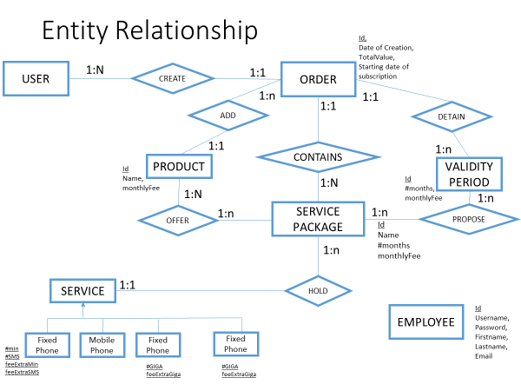

Slide 7
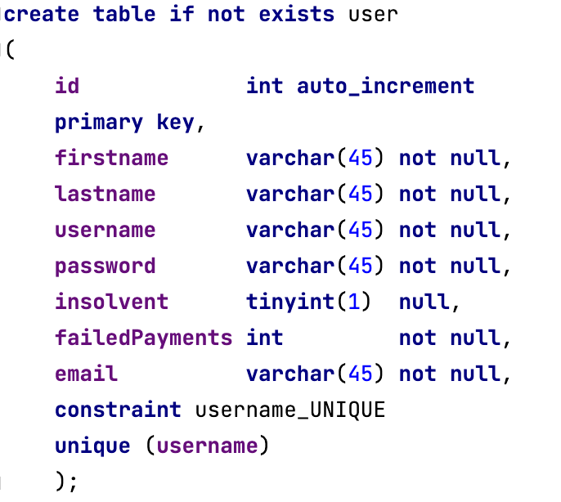
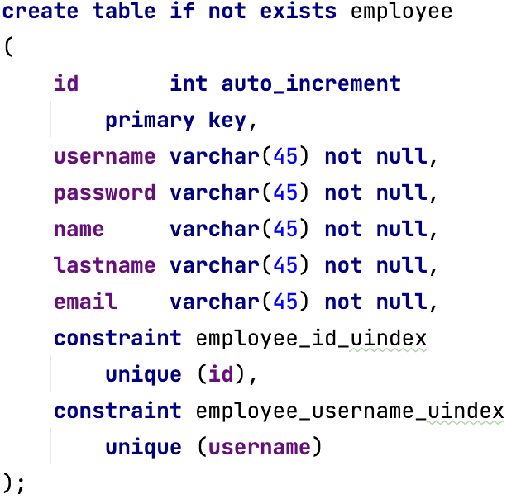
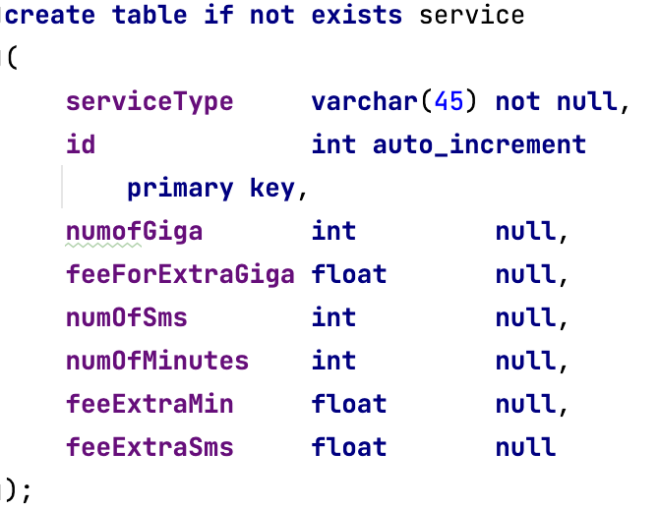
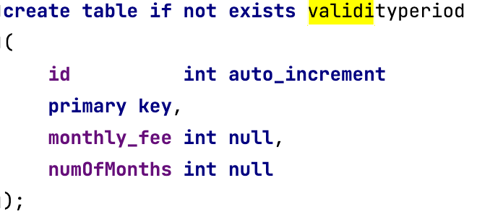
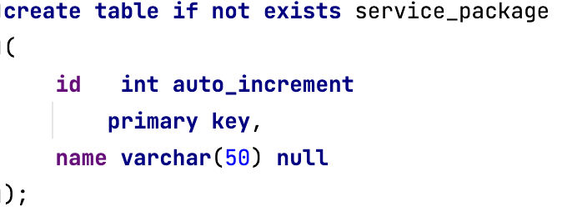
Relational model

Slide 8
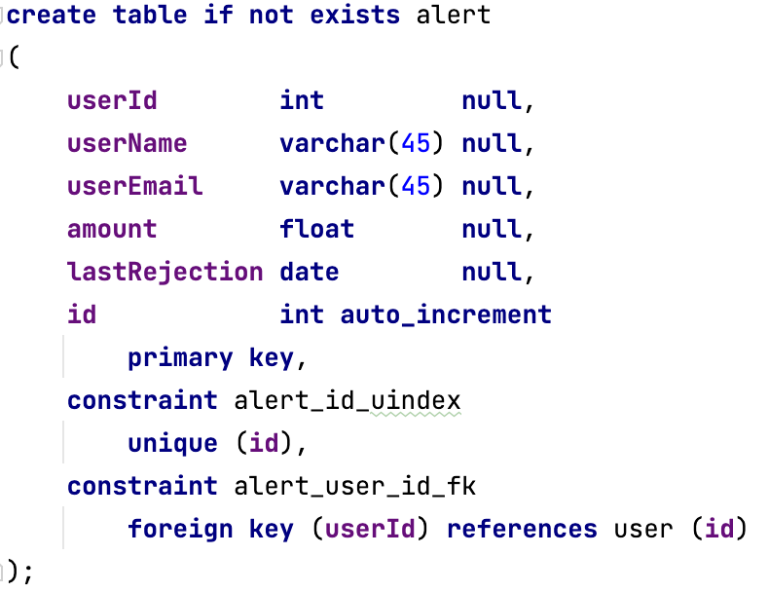
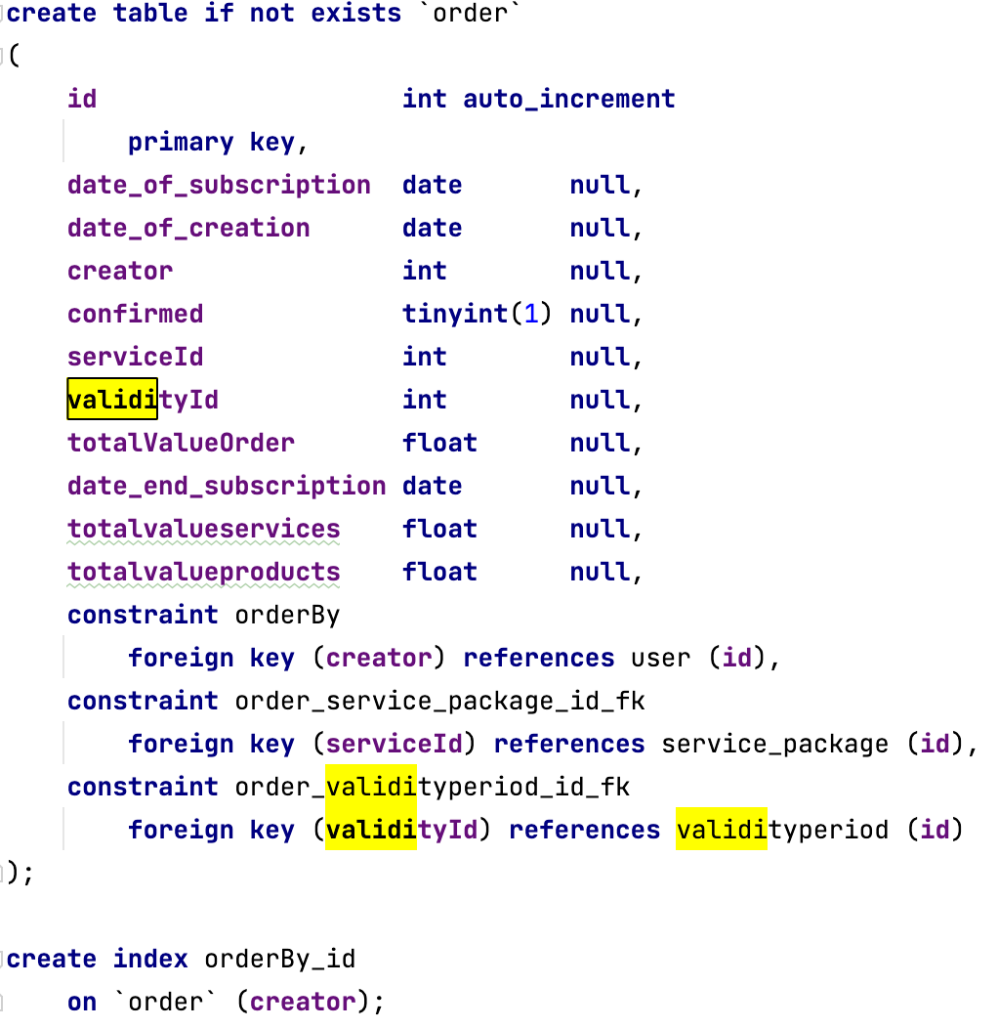
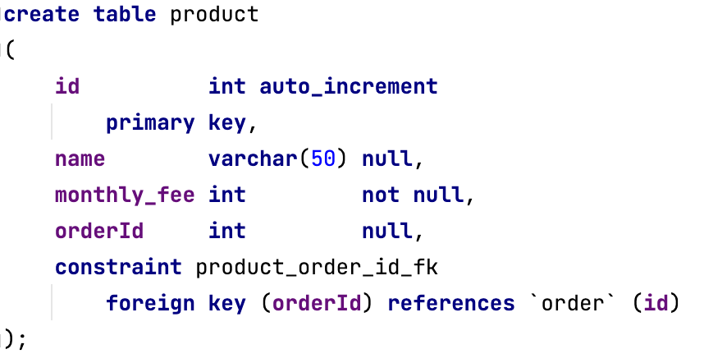
Relational model

Slide 9
Motivations
We have decided to use the order to save the choices of the user: the optional products and the validity period chosen are connected directly to the order id that is unique.
As written before, we have considered only one alert for user that can be created, updated or removed.

Slide 10
Triggers
For all the triggers we have used a “for each row” design, since the events that make the trigger starts are events that usually affect only one row in the event related table, or if more than one row is affected at the same time, they refer to different item, so it is right to run the trigger each time.

Slide 11
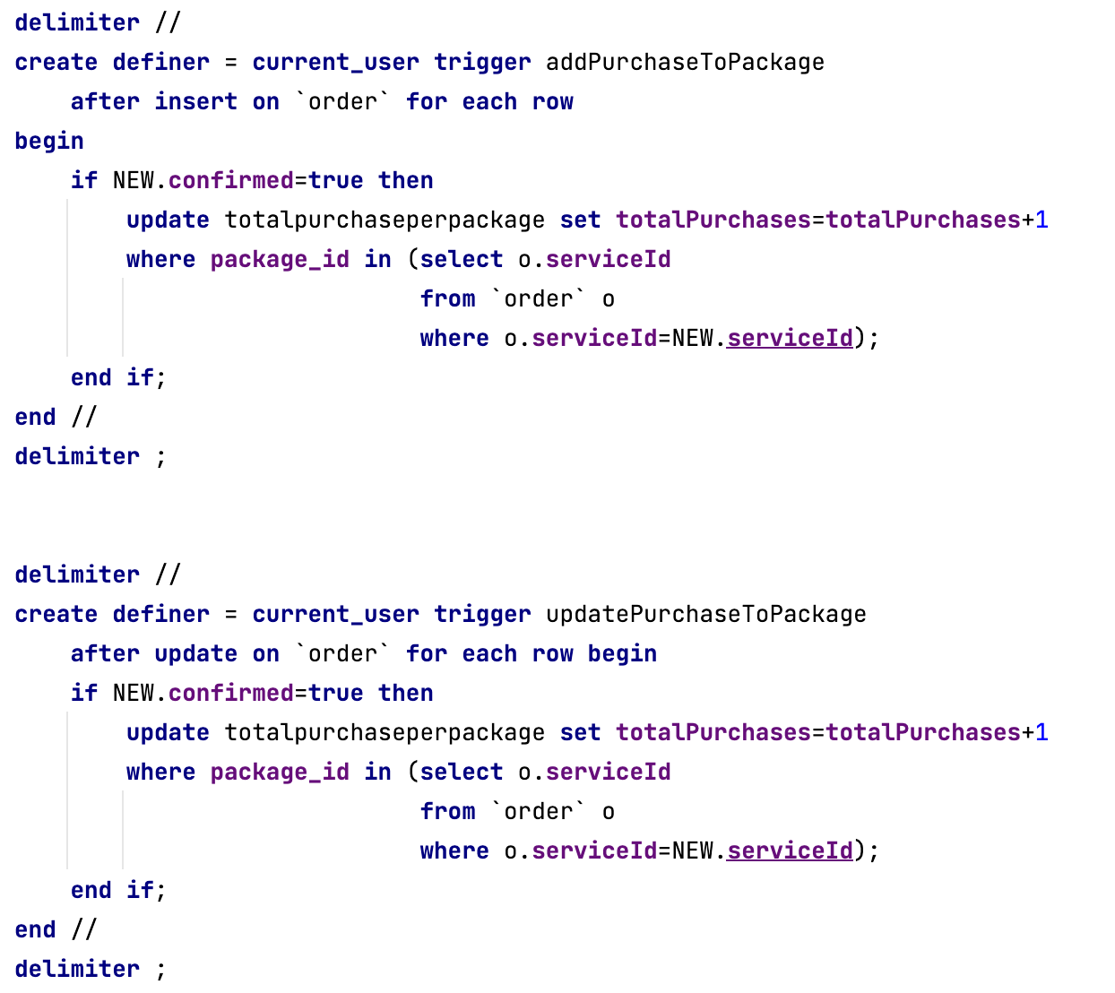
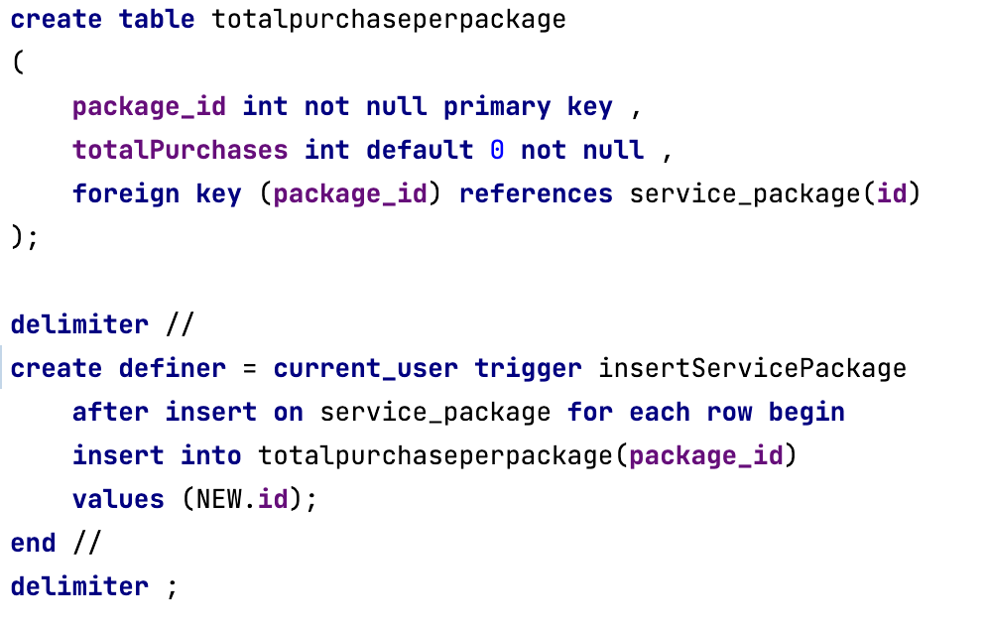
Triggers
Number of total purchases per package
Each time a service package is created, it is added to the table “totalpurchaseperpackage”.
Then each package purchase data is incremented when an order is placed with that service package connected. This happens only when a new order is created and the payment is confirmed or when an old order changes state from rejected to confirmed, trough the update trigger.

Slide 12
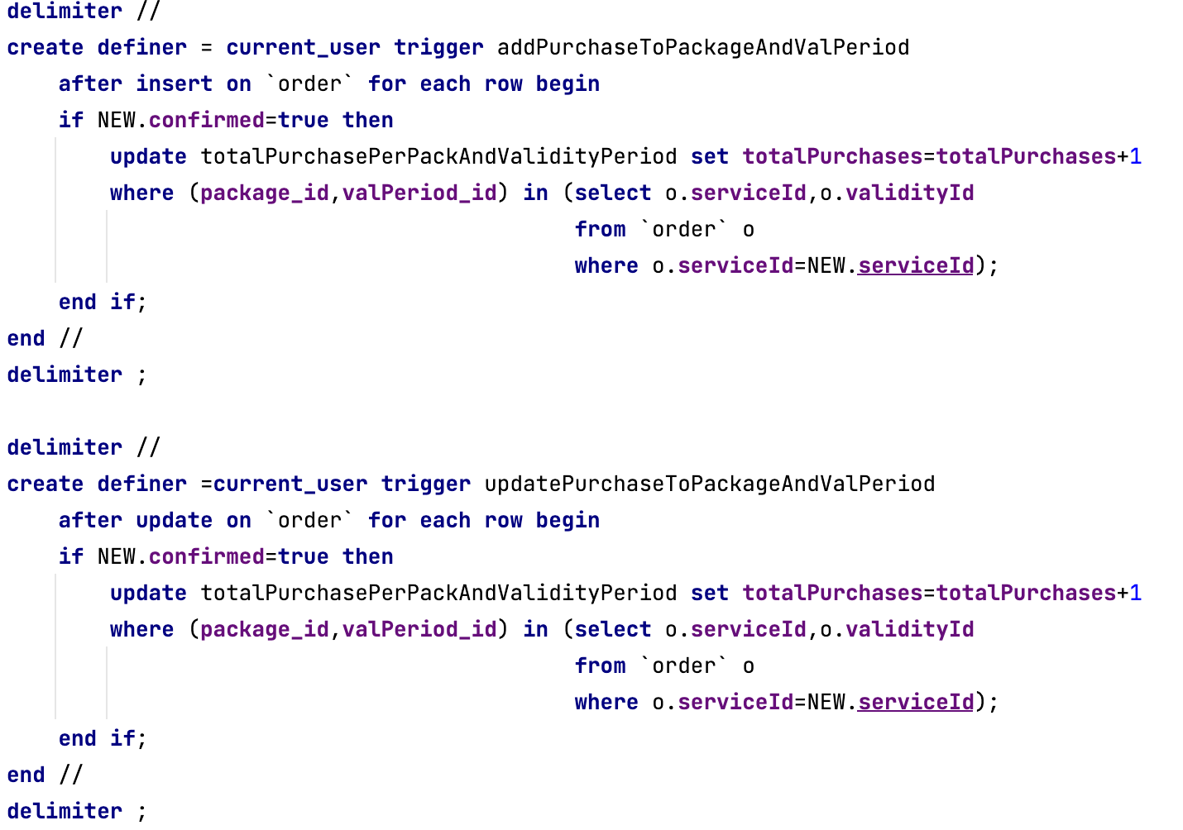
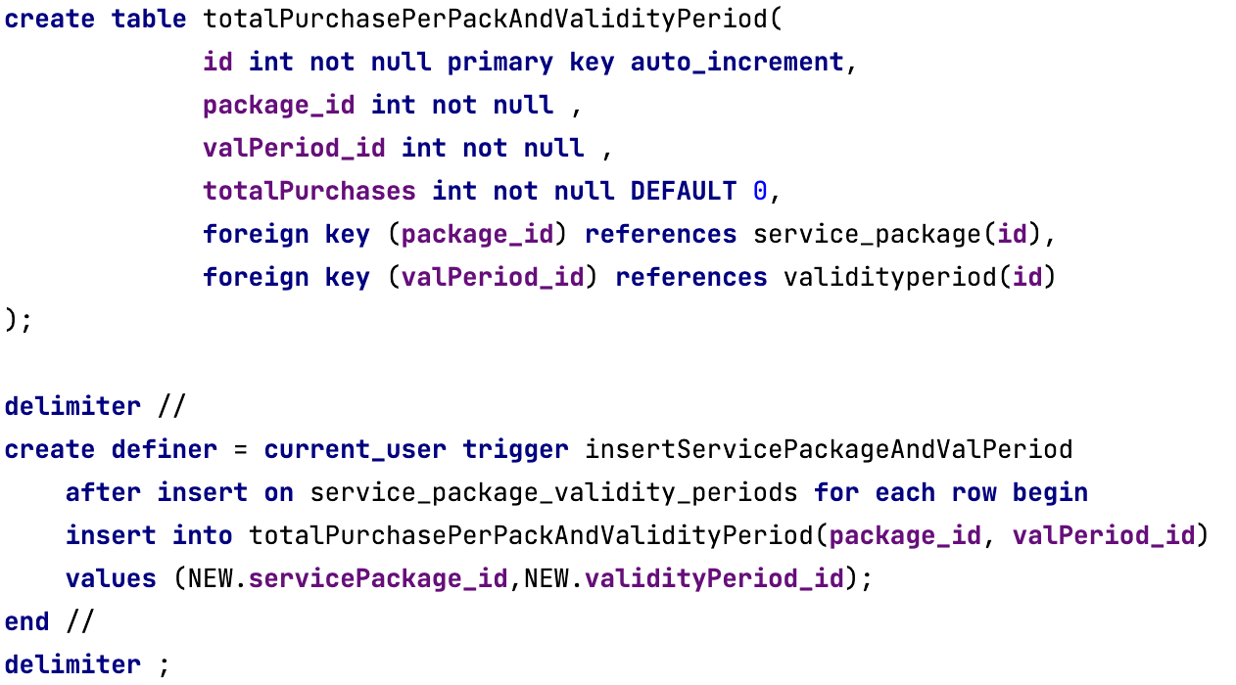
Triggers
Number of total purchases per package and validity period
Each time a service package is created and the connections with the validity periods are added to the manytomany table, both the package and the validity periods related are added to the table “totalpurchaseperpackageandvalidity”.
Then each package purchase data is incremented when an order is placed with that service package connected. This happens only when a new order is created and the payment is confirmed or when an old order changes state from rejected to confirmed, trough the update trigger. The row updated in the “totalpurchaseperpackageandvalidity” is the one with the package and validity period connected to the order.

Slide 13
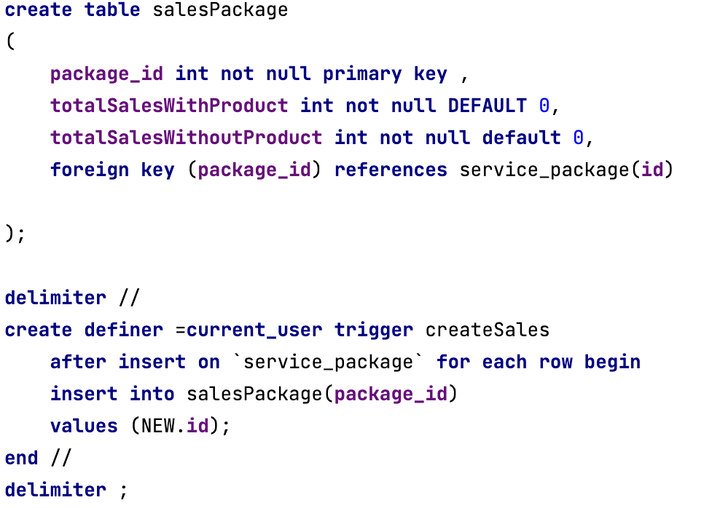
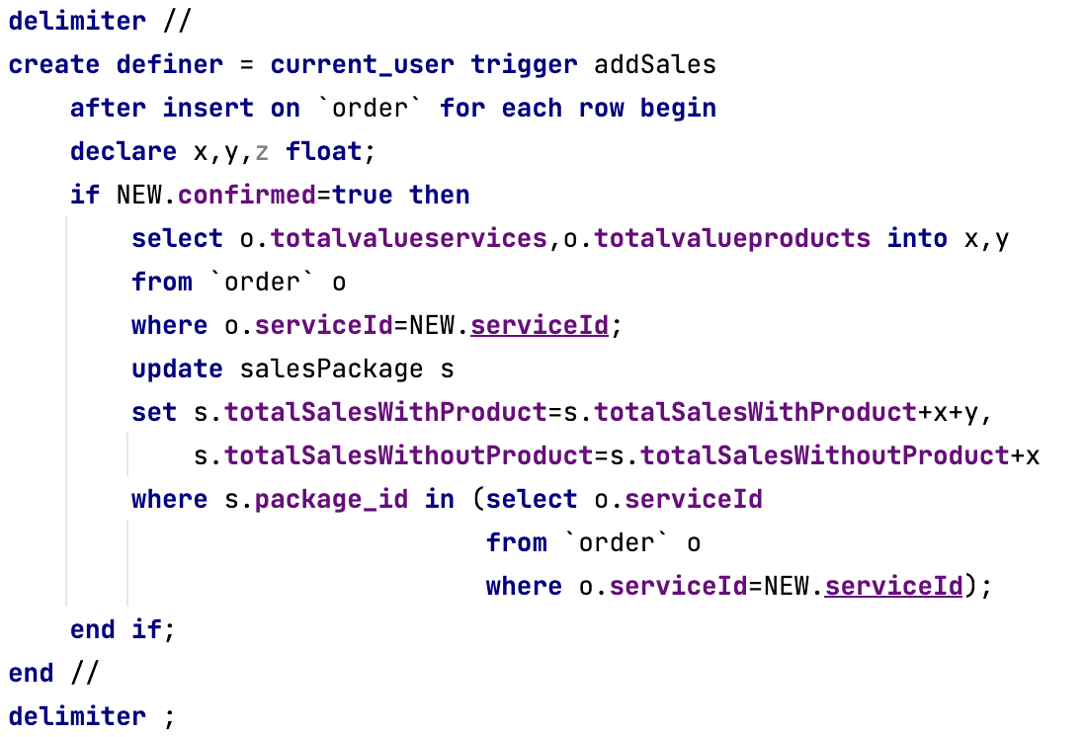
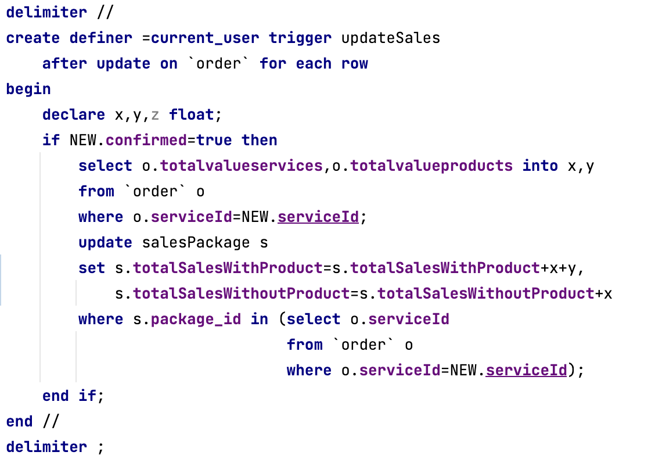
Triggers
Total value of sales per package with and without the optional products
Each time a service package is created, it is added to the table “salesPackage”.
Then when an order is placed and the payment is confirmed or when an old order changes state from rejected to confirmed, the in the salesPackage table the values data are updated with the values present in the order, the row affected is the one with the service package id equal to the package connected to the order.

Slide 14
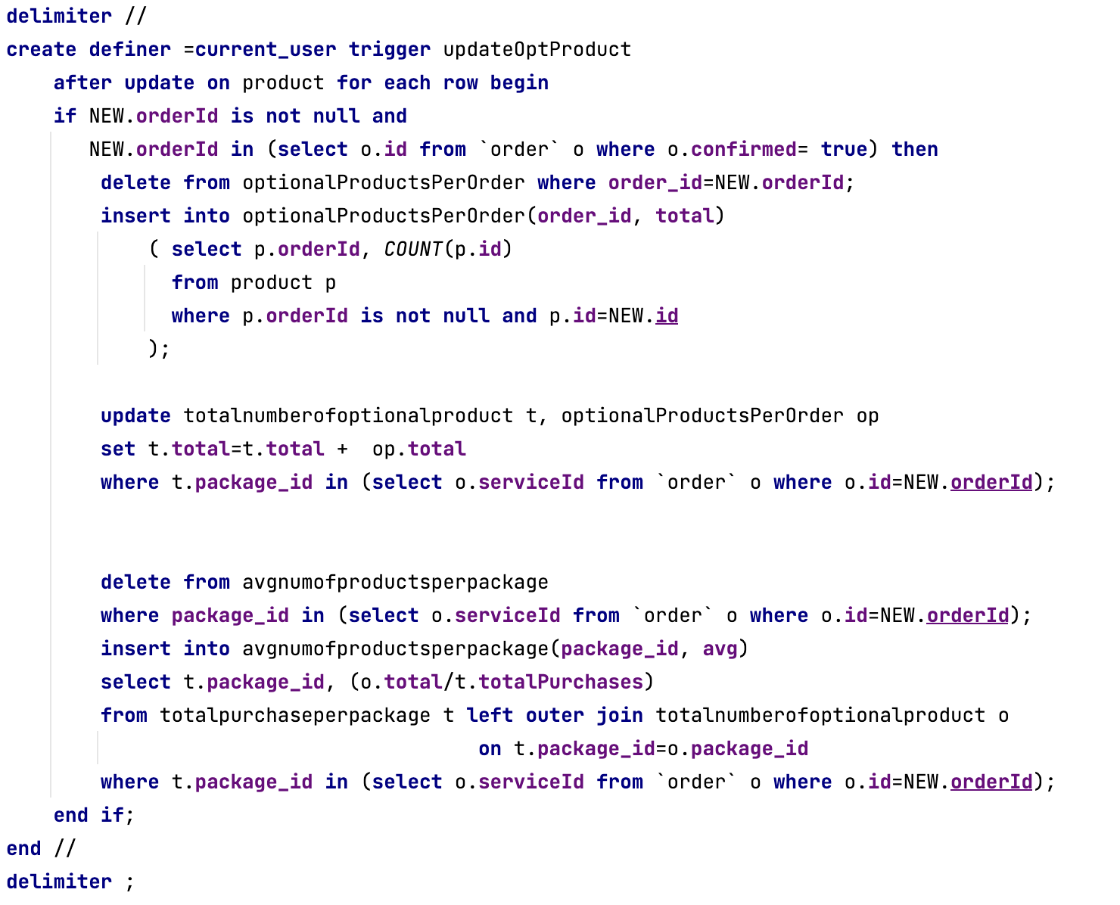
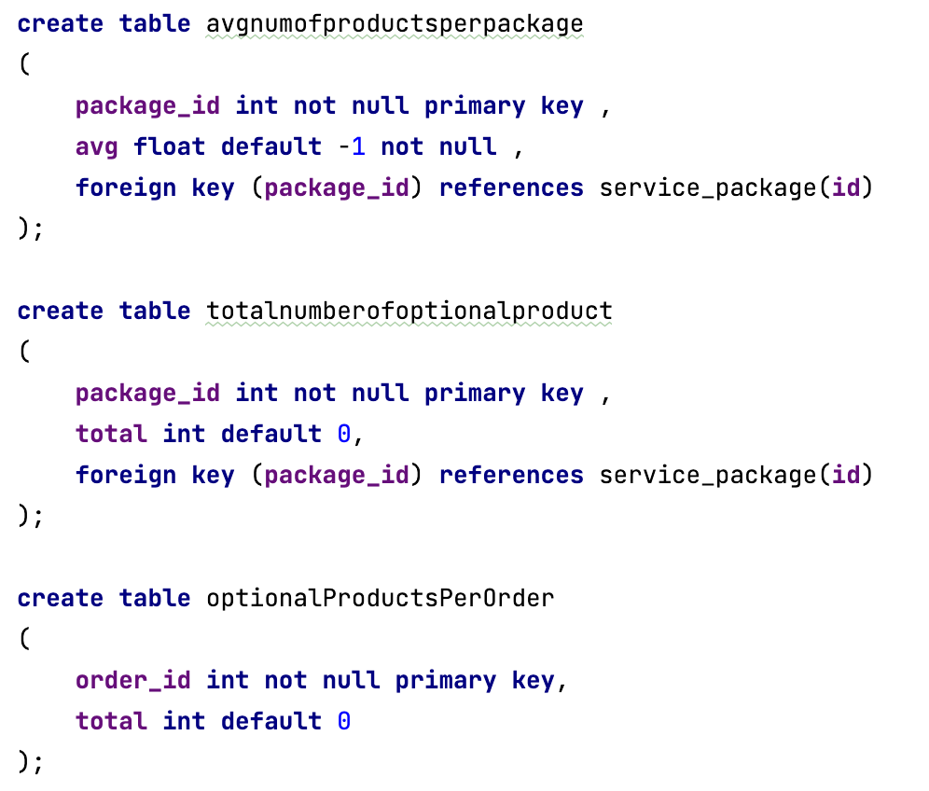
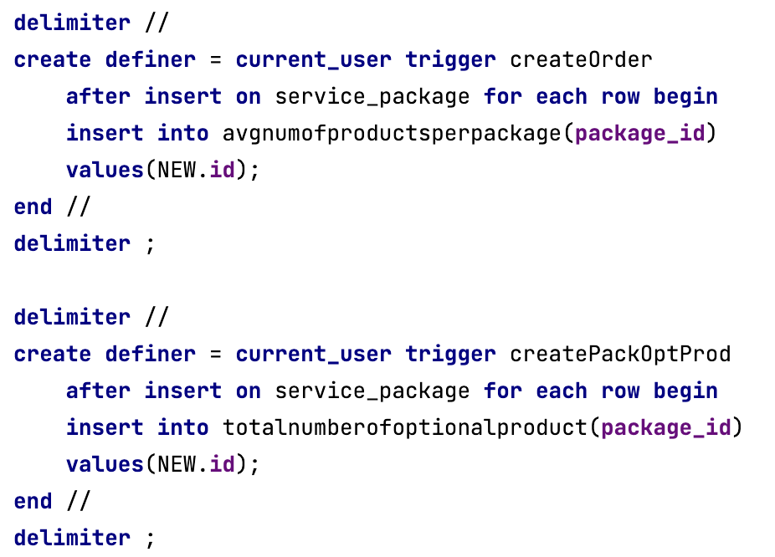
Triggers
Average number of optional products sold together with each service package
For this trigger we have used three tables, one for the effective average, one to save the number of opt products sold for each package and one table used to check the connection between the opt products and the orders.
The first two tables are initialized with the service packages when these are created.
Each time an order is placed or updated and the payment is confirmed, the opt products are updated with the orderId related.
So this trigger is based on the update of the opt products and from their table it gets the data to fill the “totalnumberofoptionalproduct” and the “optionalProductsPerOrder”. Then the “totalnumberofoptionalproduct”,where there are the opt prods sold for each package, is used to calculate the average together with the “purchaseperpackage” table.

Slide 15
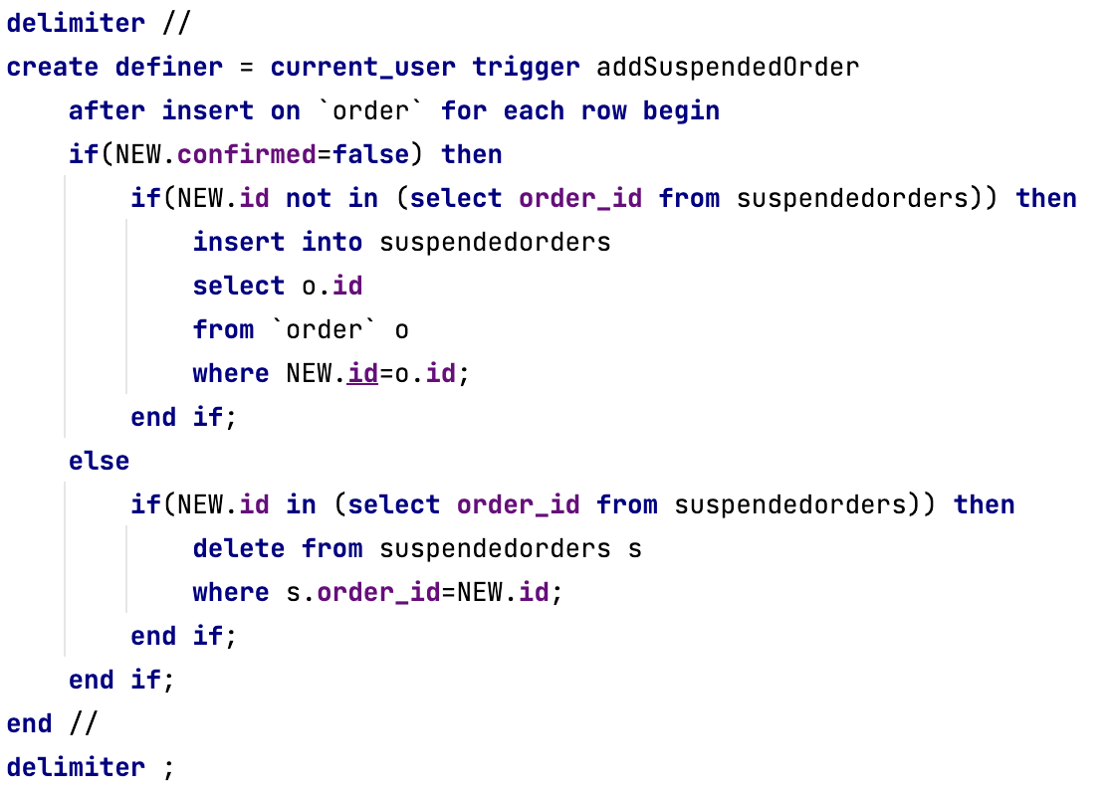
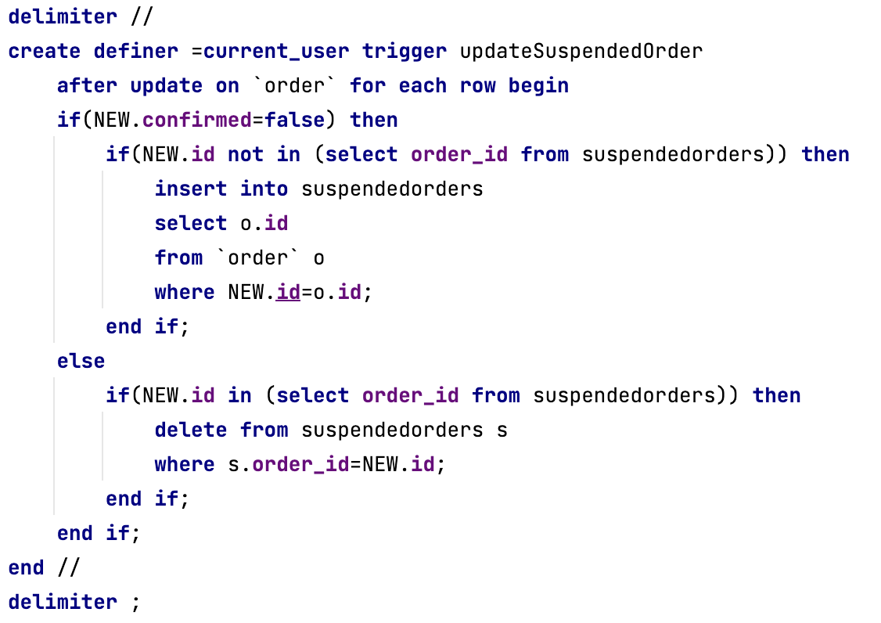
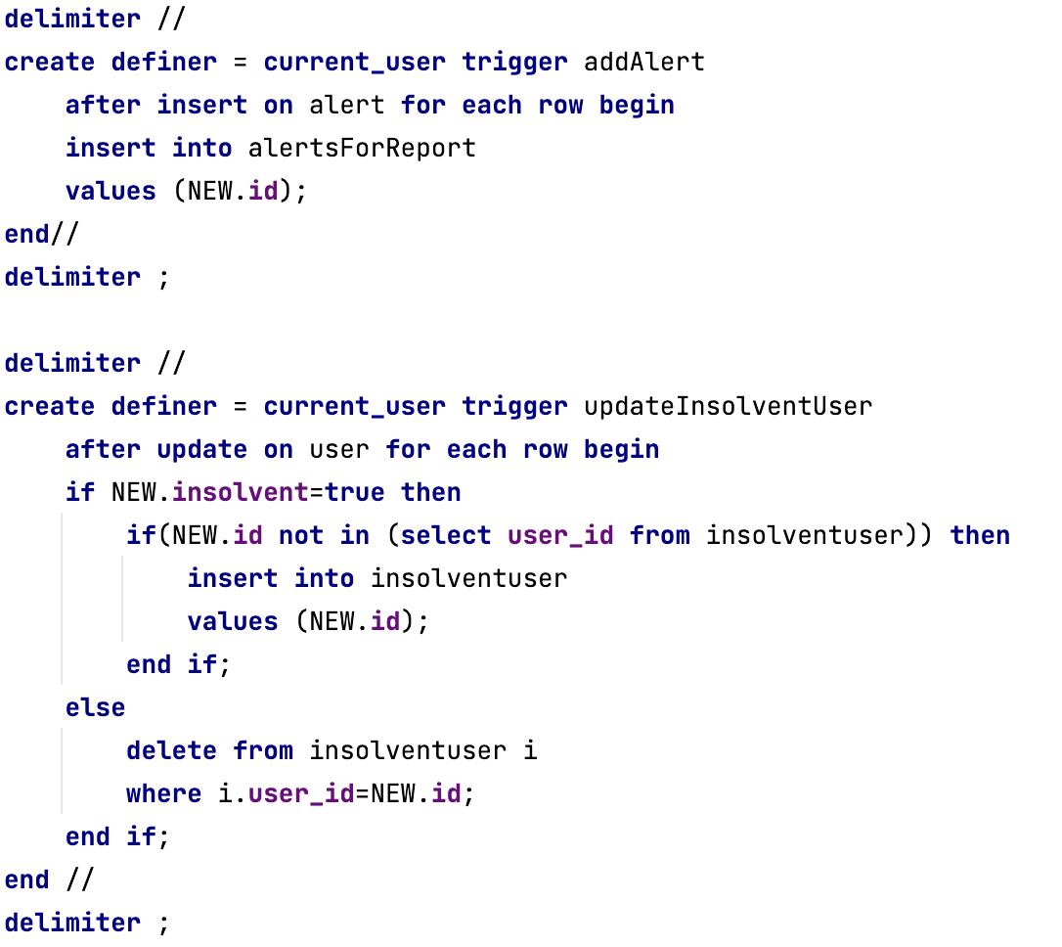
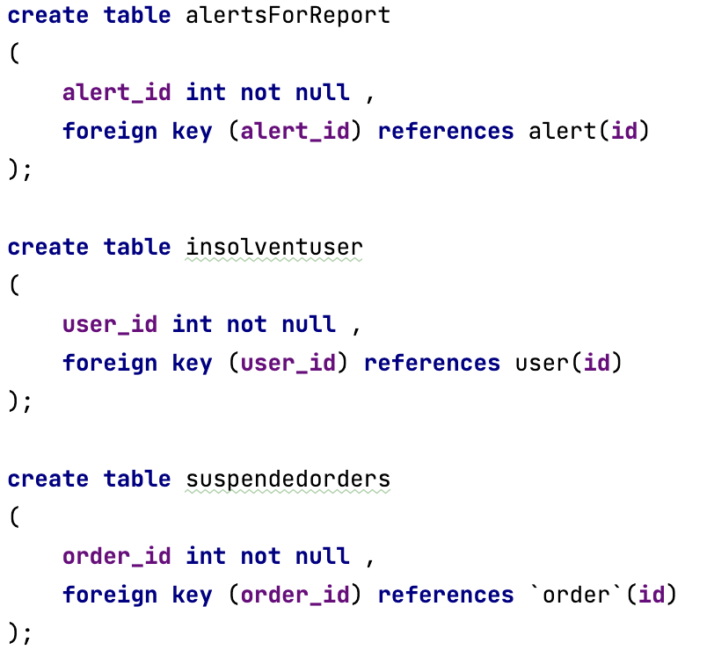
Triggers
List of insolvent users, suspended orders and alerts
For this trigger we have used three tables, one for each item.
The “alerts” table is filled when an alert is created, whereas the “insolvent users” table is filled when a user status is updated.
The “suspended orders” table is filled when an order is created or updated with rejected payment, whereas when an order is updated with confirmed payment, the order is removed from the table.

Slide 16
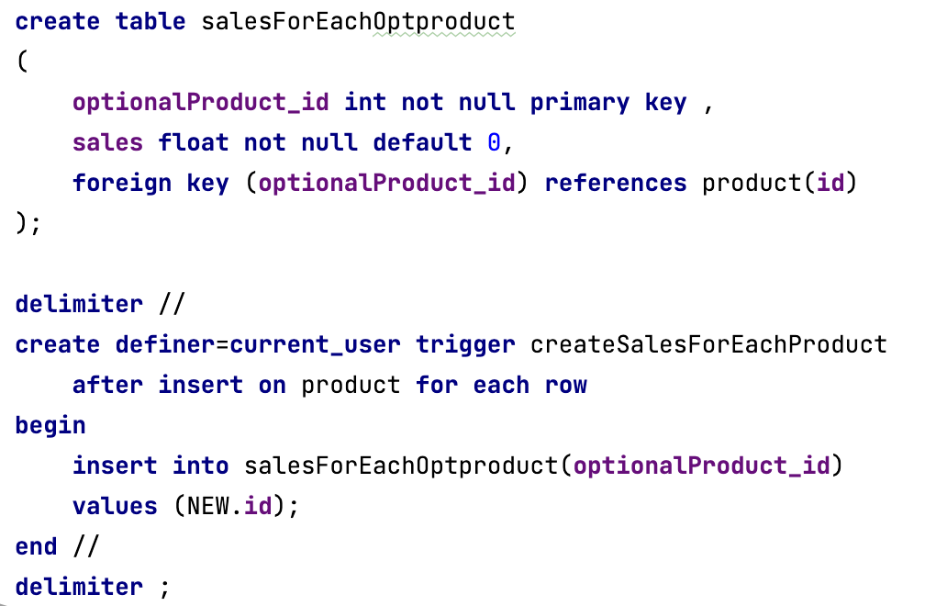
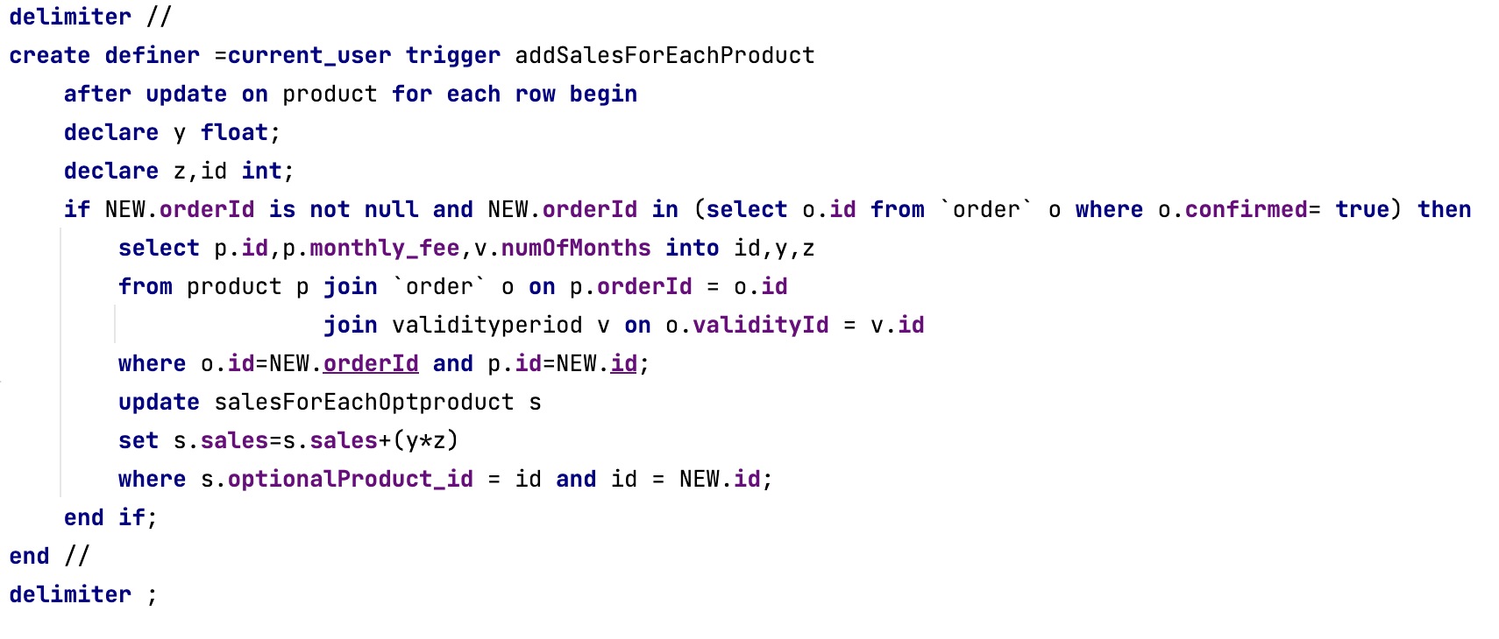
Triggers
Best product
For this trigger we have used the “salesForEachProduct” table that is initialized when a new product is created.
This table is updated when a product is sold with the amount updated adding the order amount corresponding to the product.
The best product is found trough a query, getting the product with the max amount.

Slide 17
ORM design

Slide 18
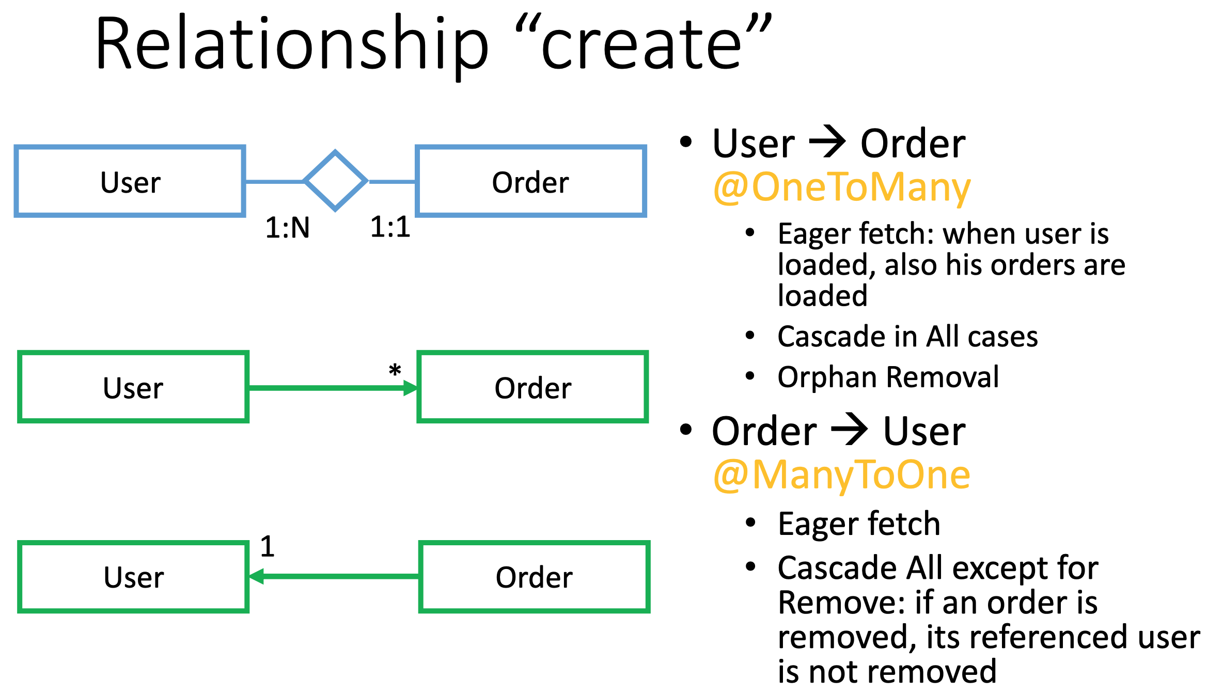

Slide 19
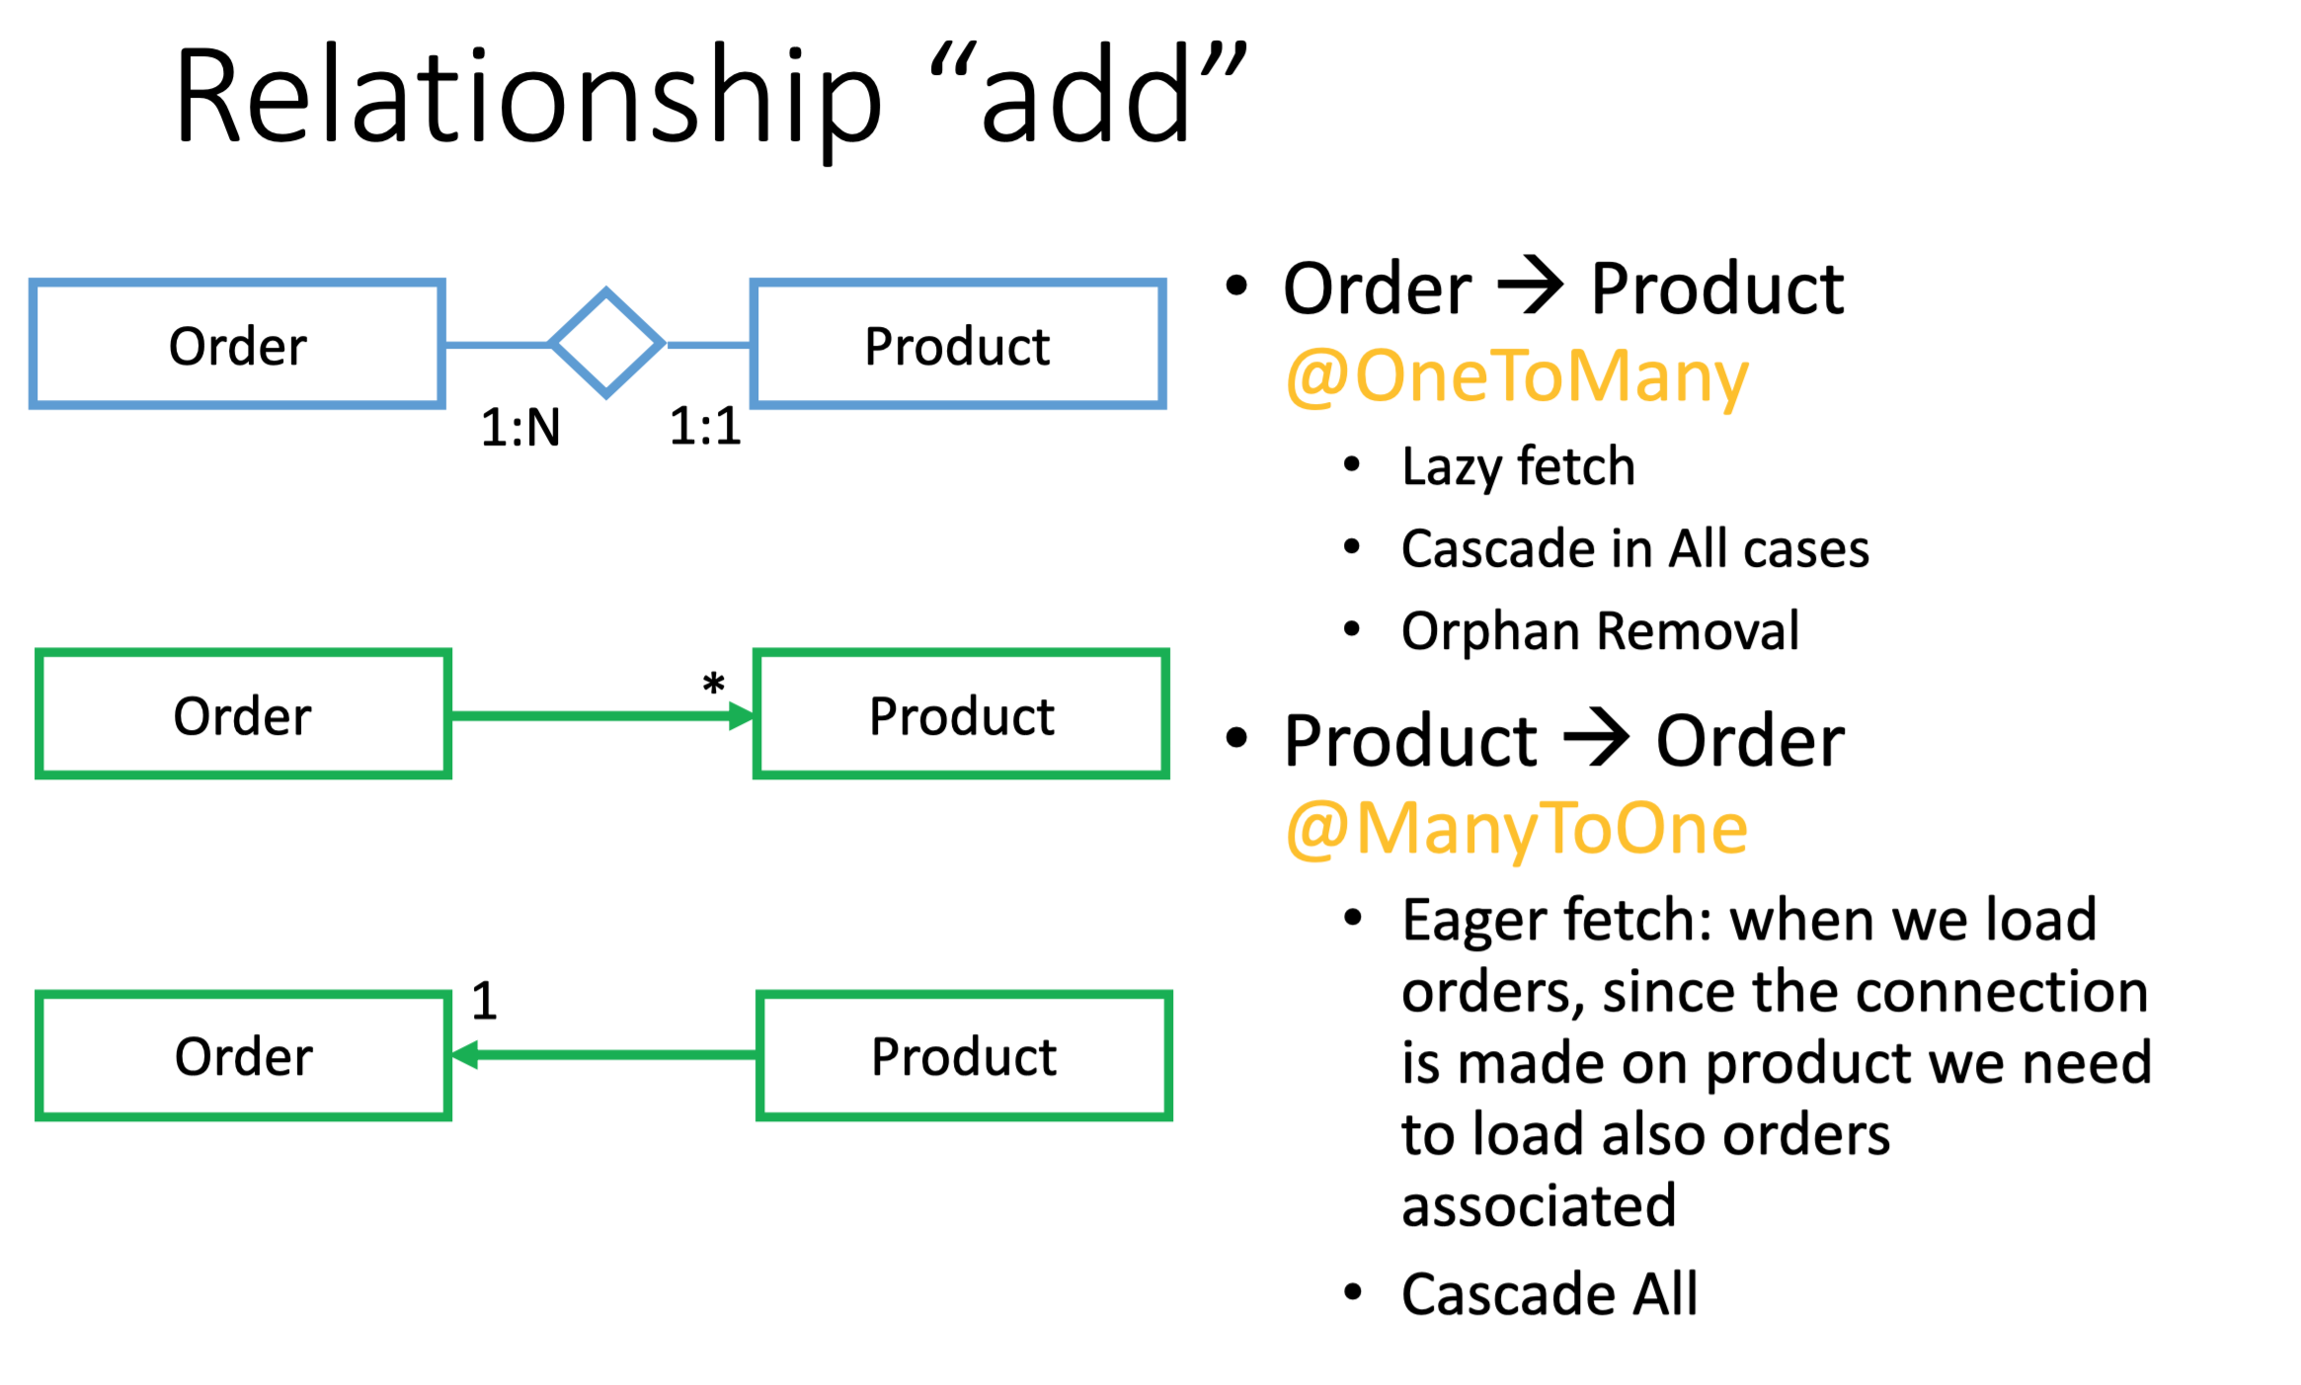

Slide 20
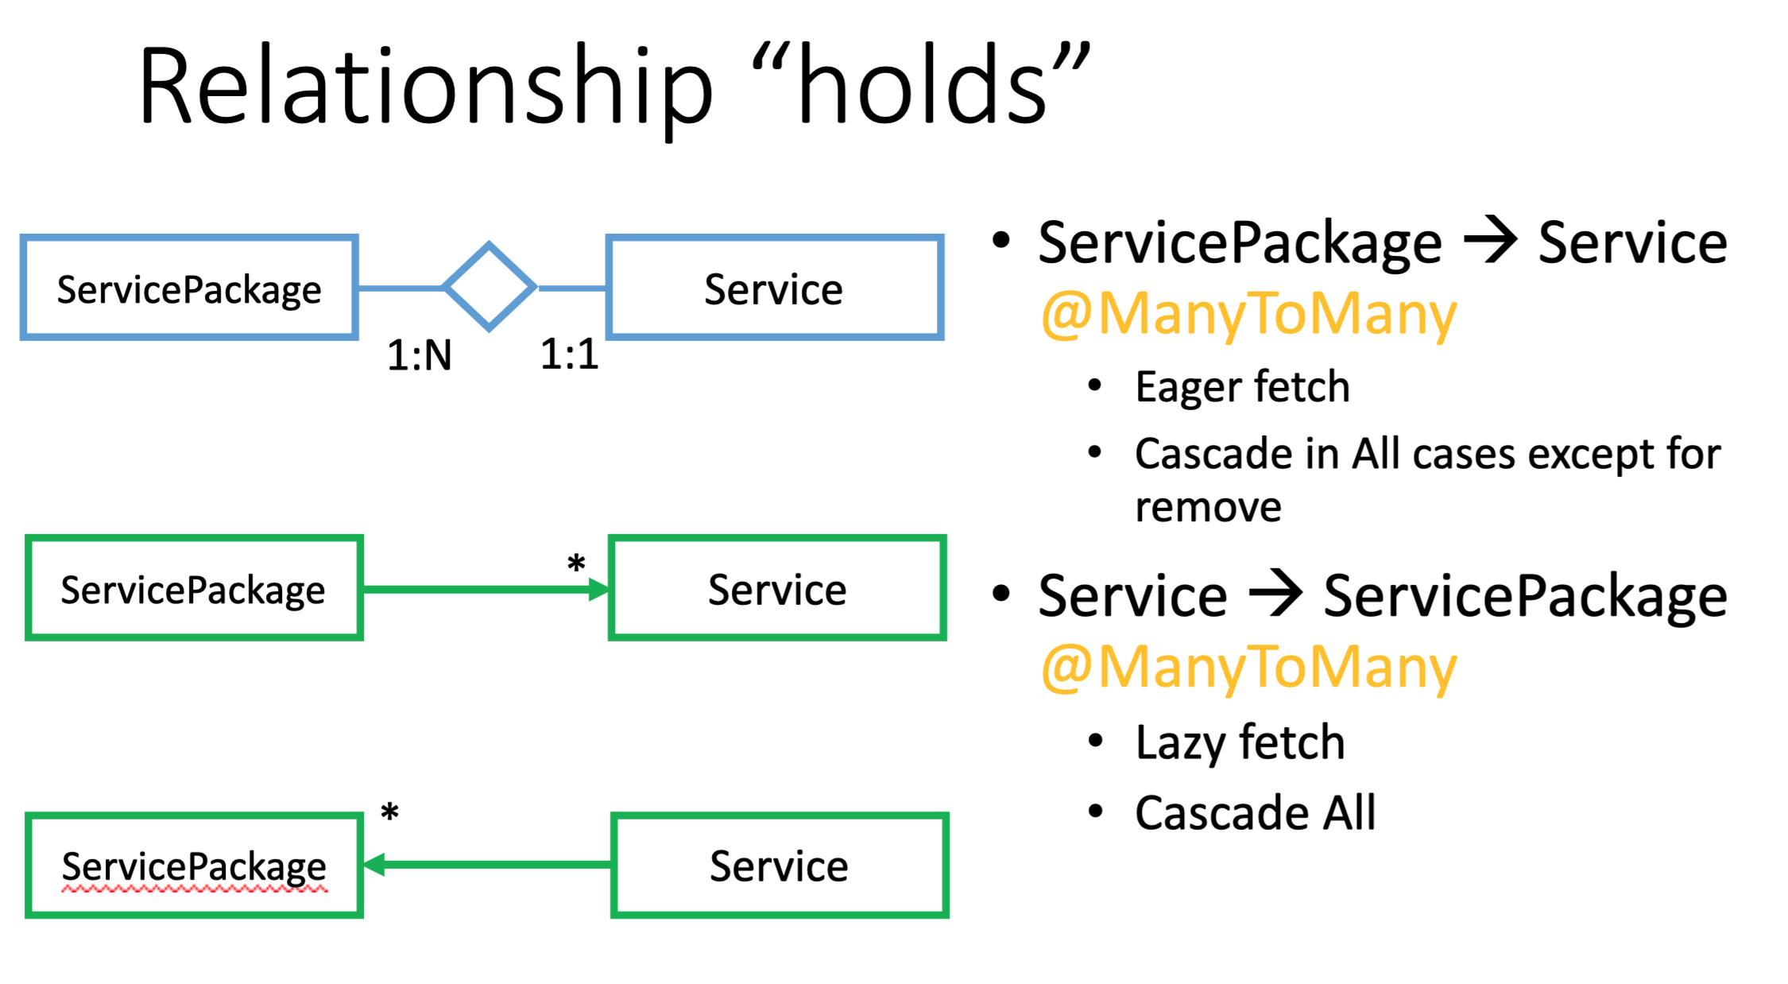

Slide 21
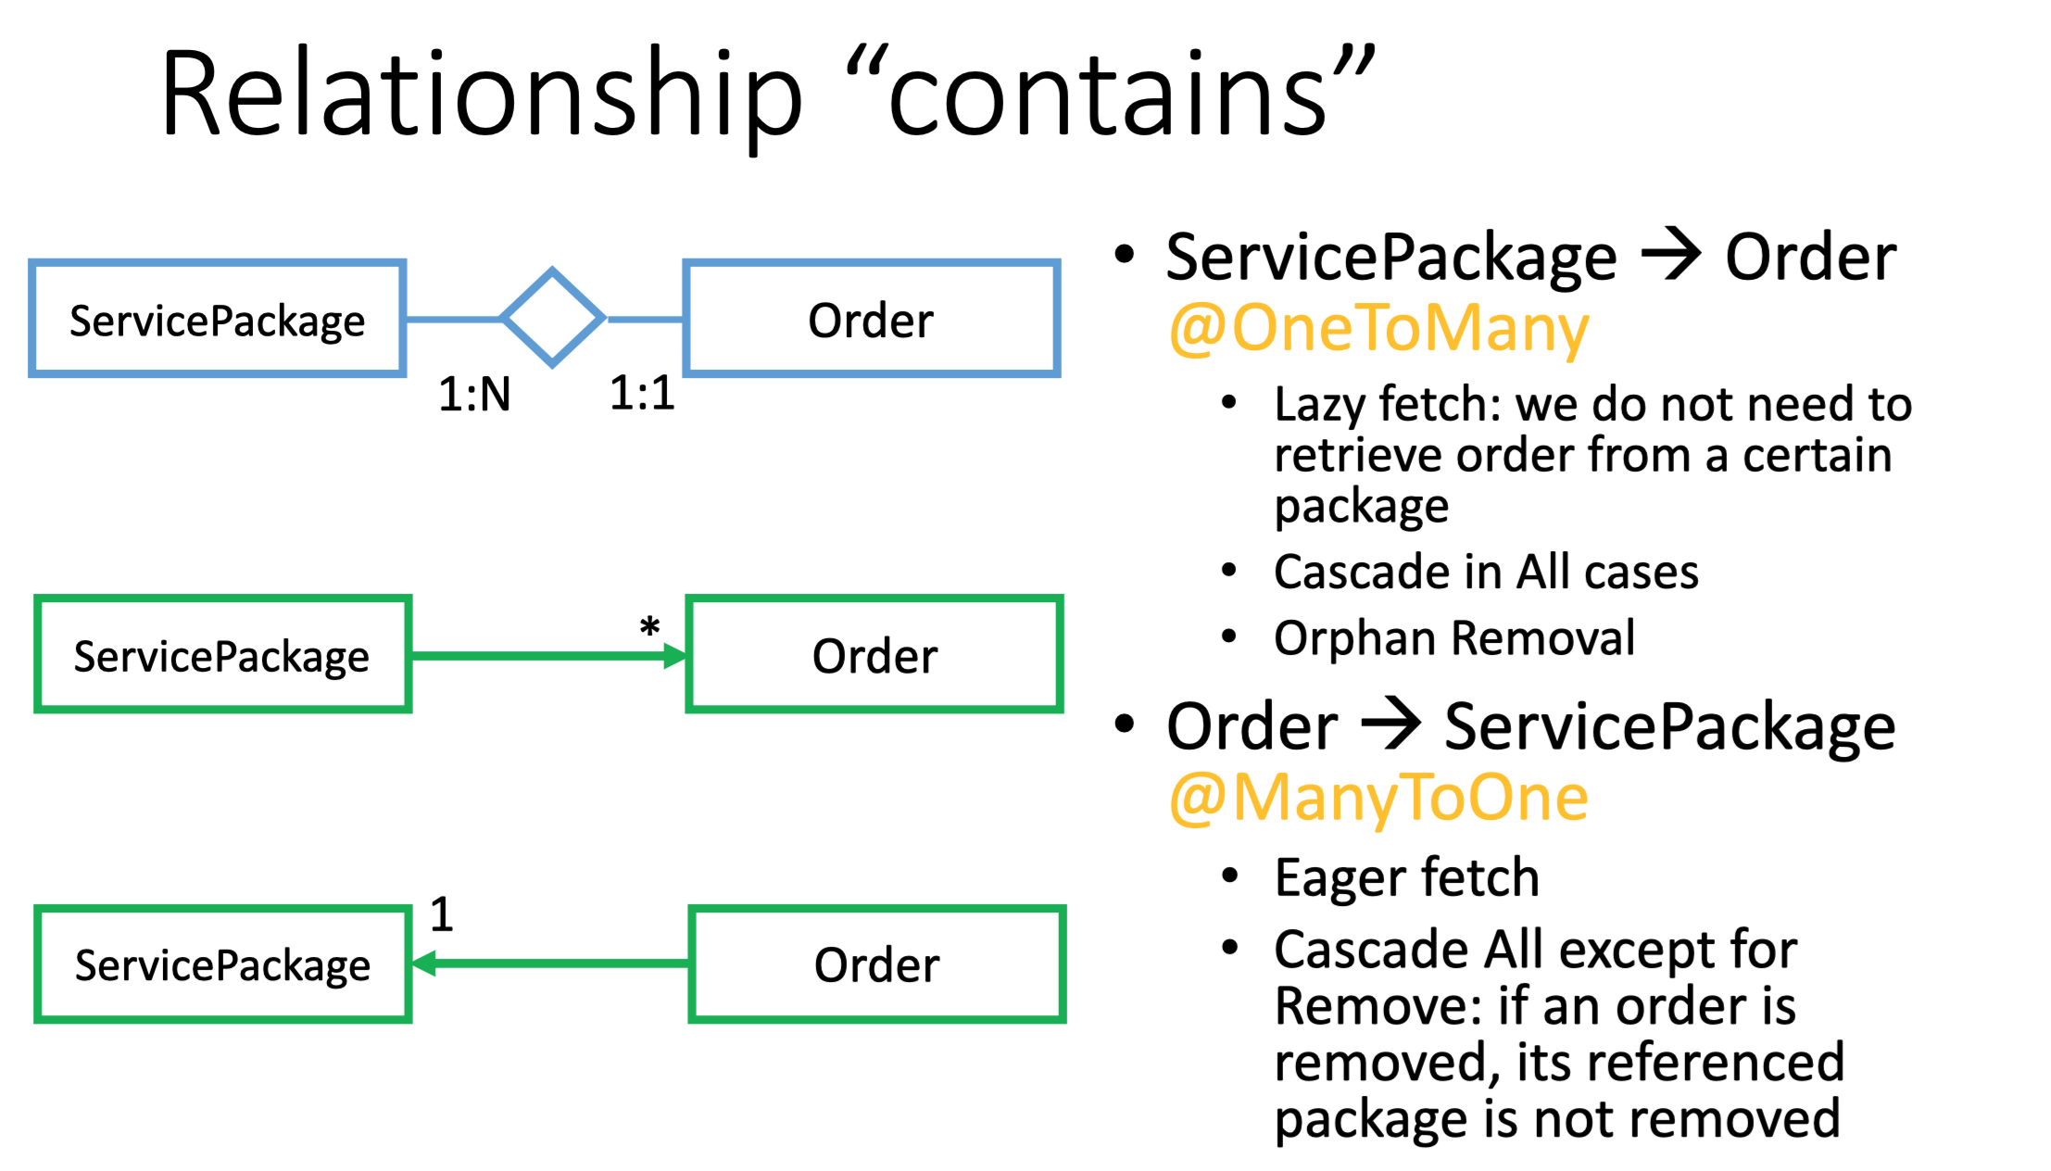

Slide 22
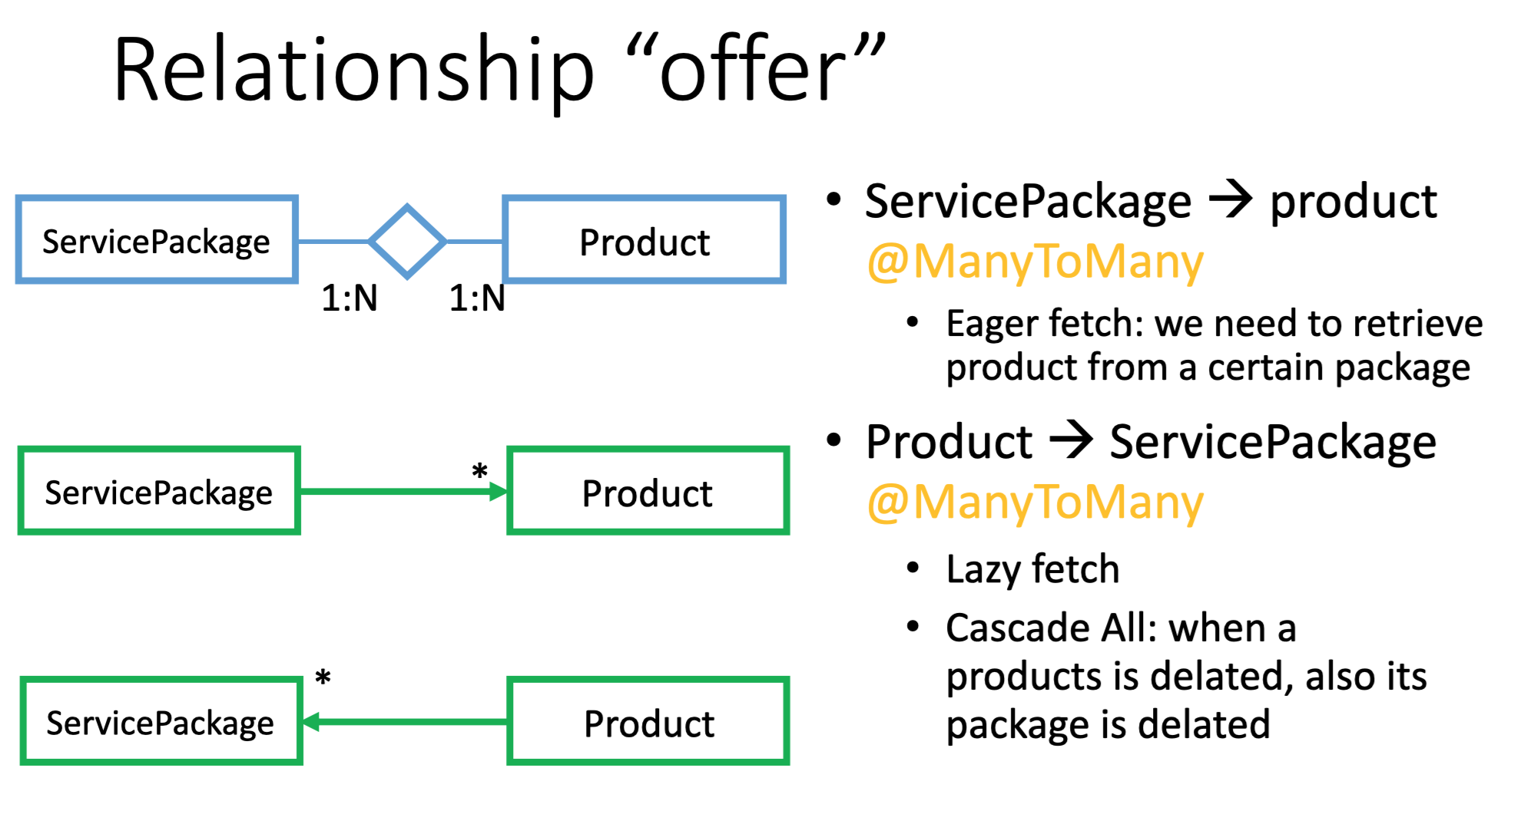

Slide 23
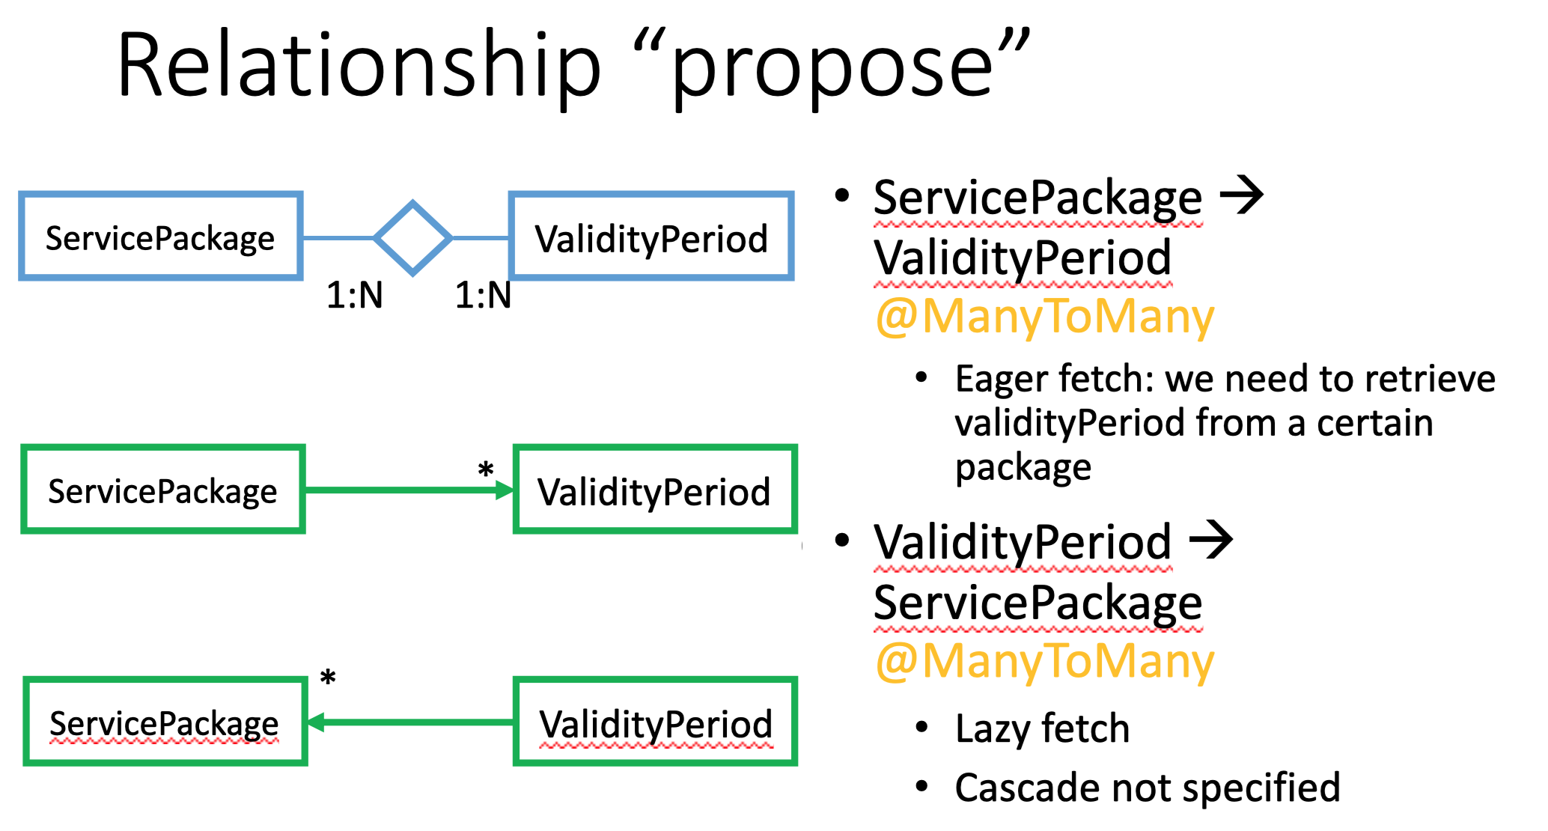

Slide 24
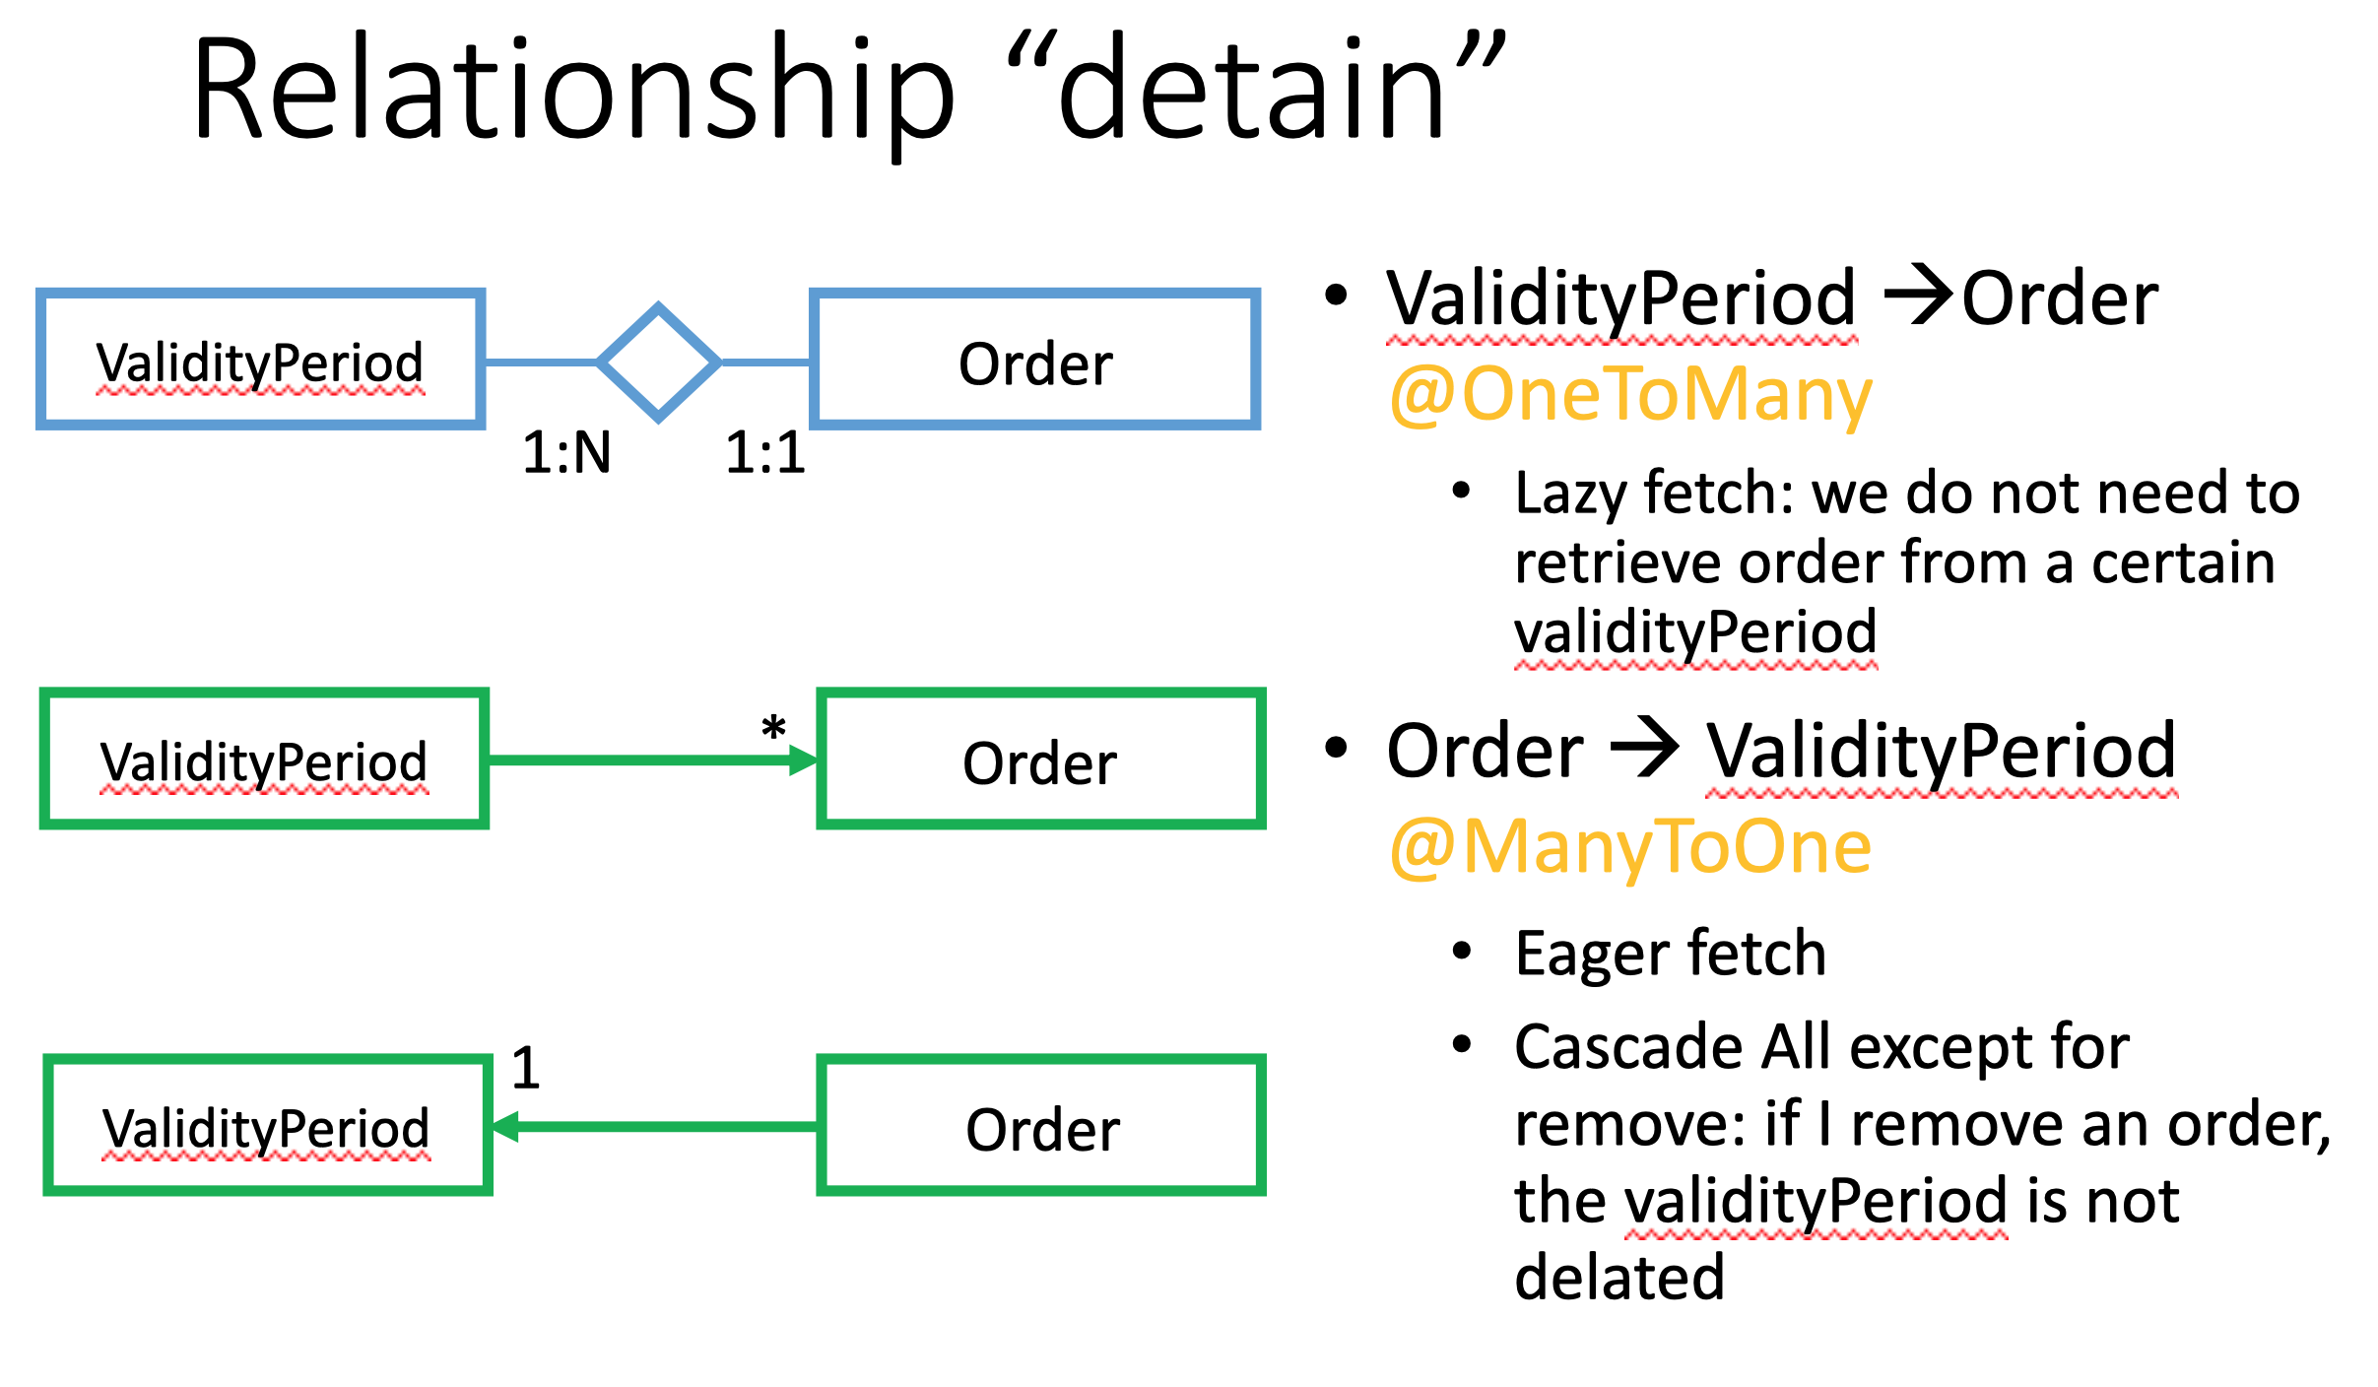

Slide 25
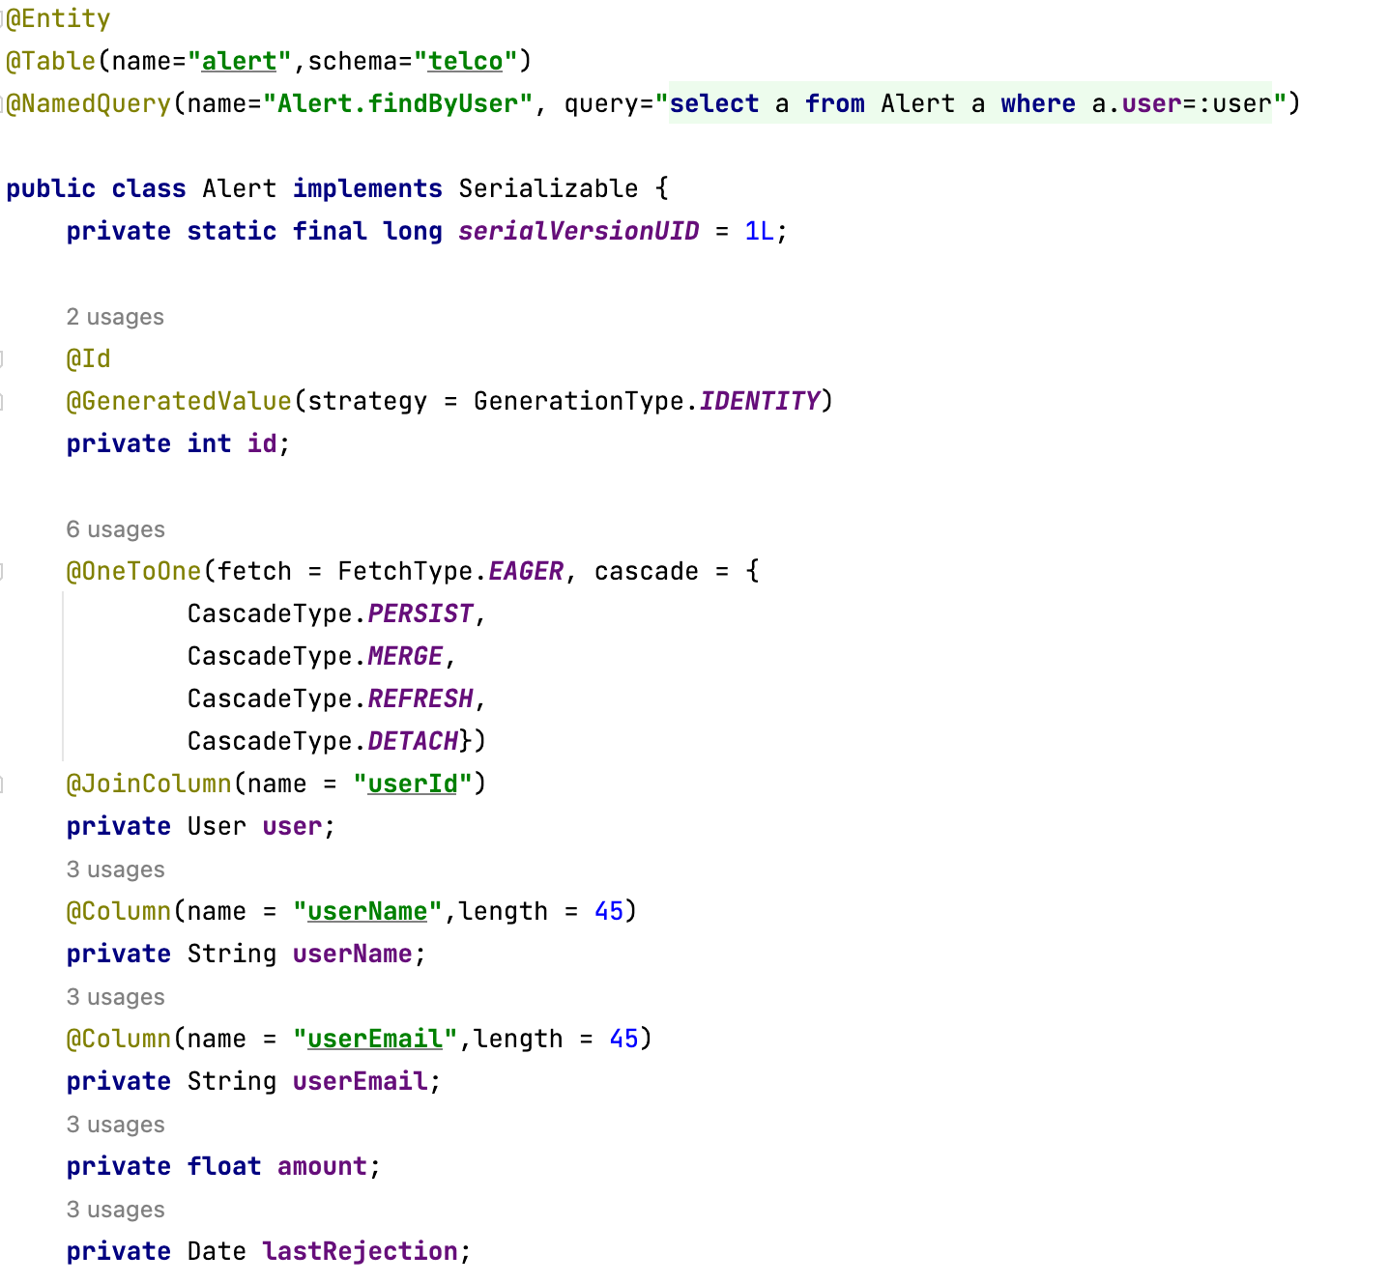
Alert Entity

Slide 26
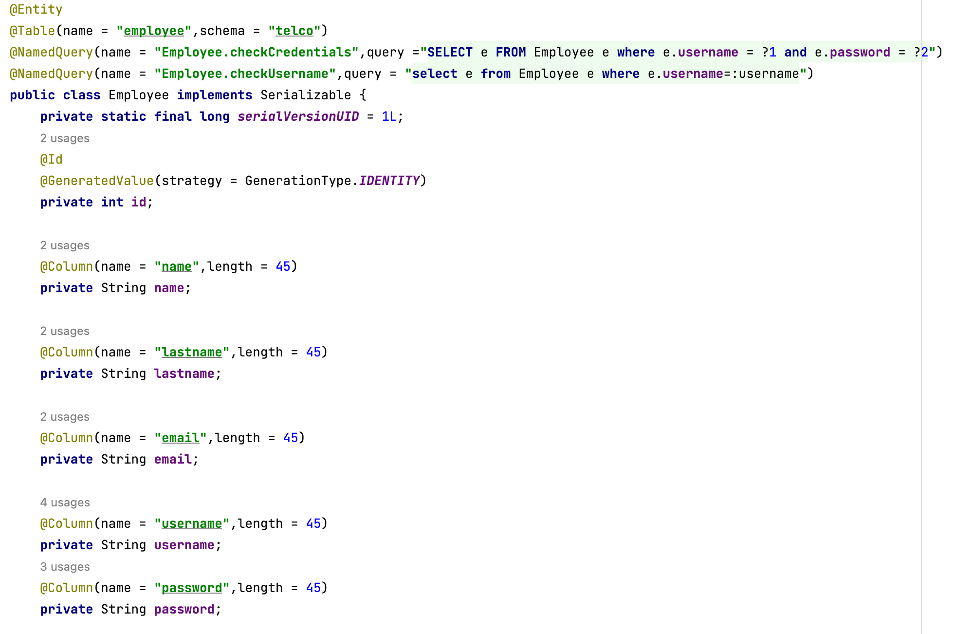
Employee Entity

Slide 27
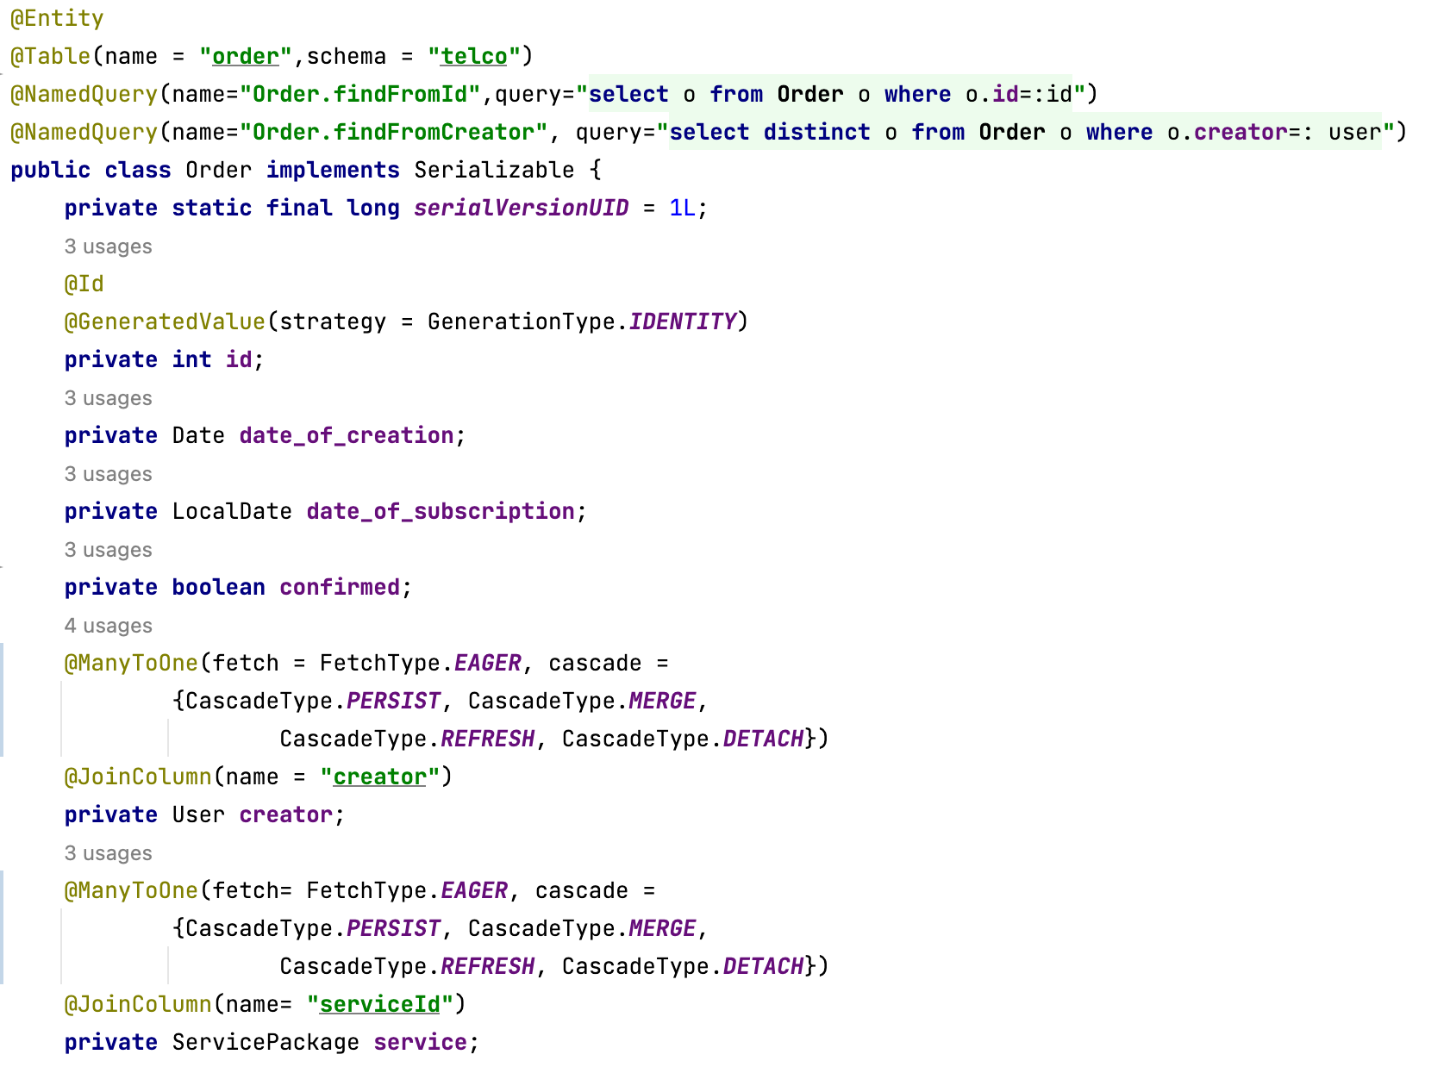
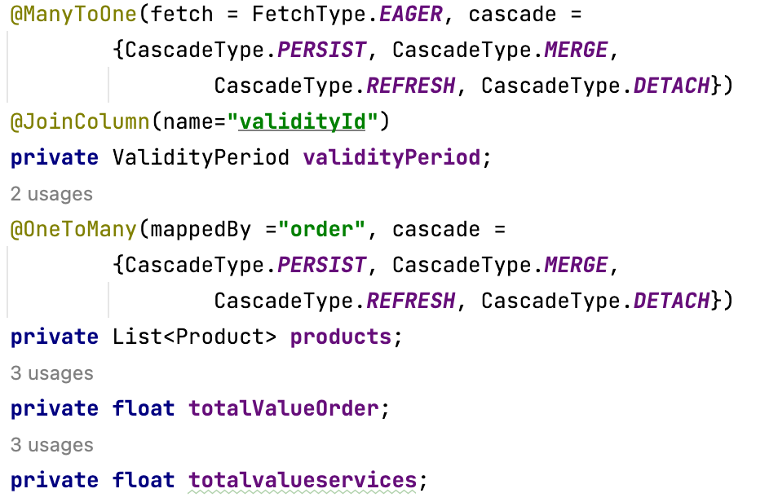
Order Entity

Slide 28
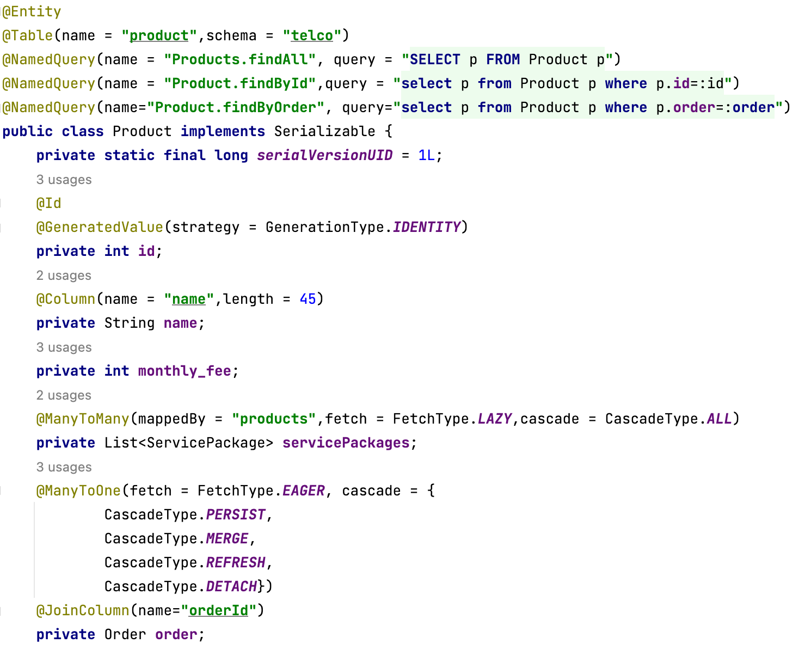
Product Entity

Slide 29
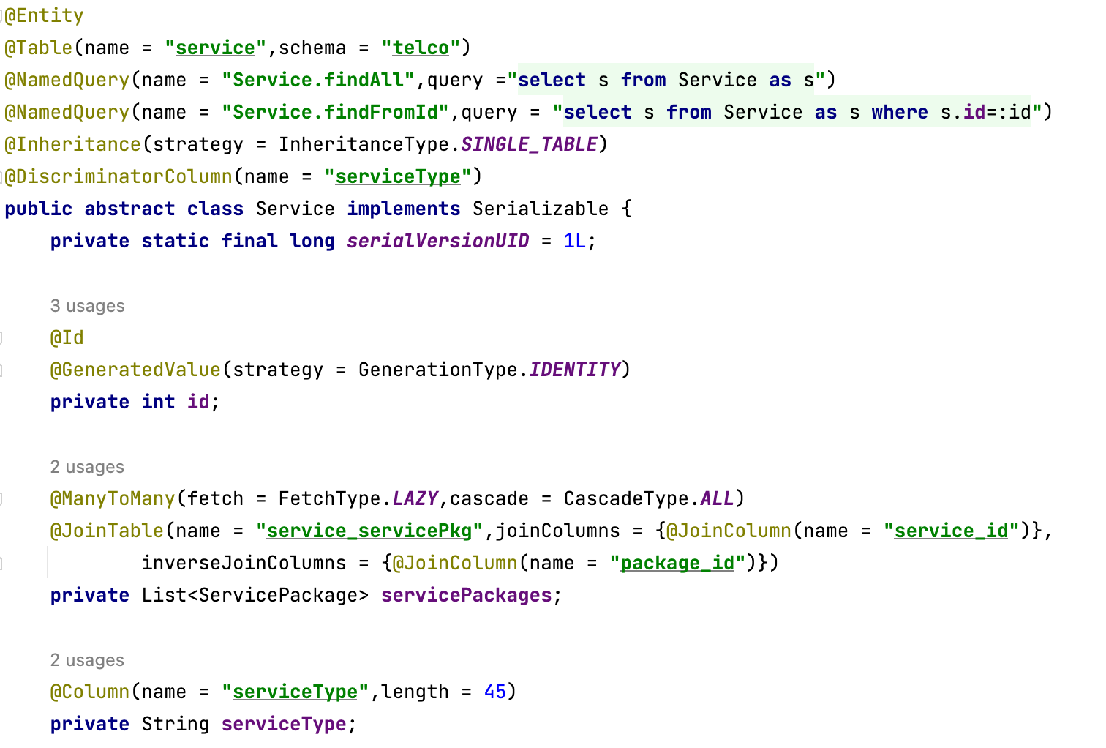
Service Entity

Slide 30
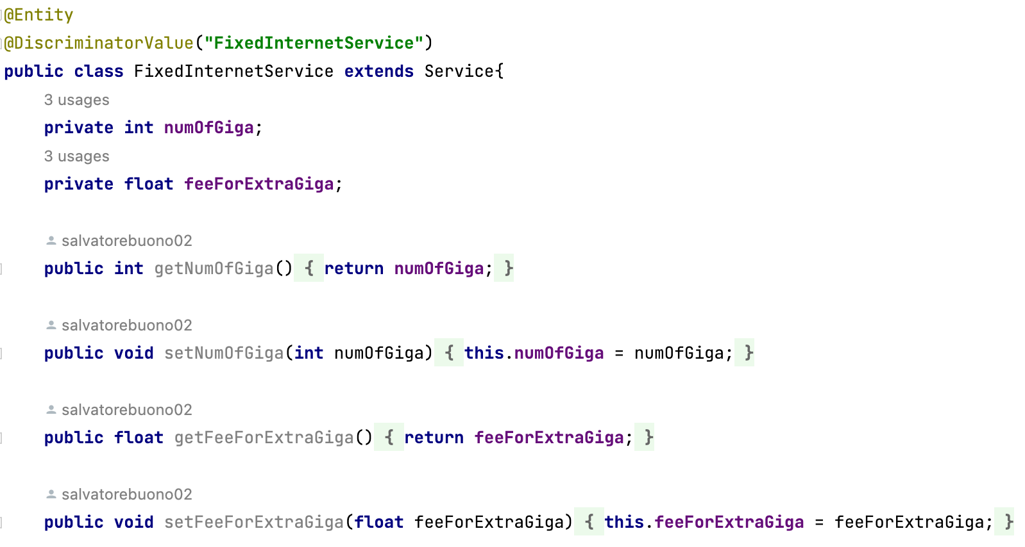
FixedInternetService Entity

Slide 31
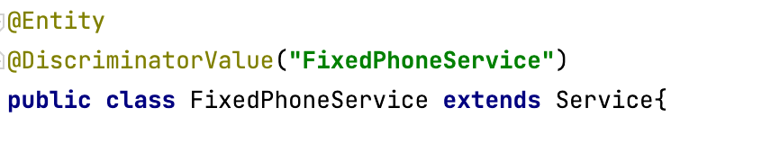
FixedPhoneService Entity

Slide 32
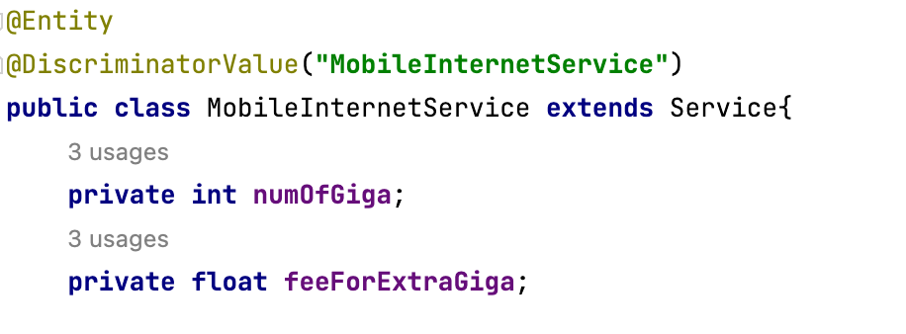
MobileInternetService Entity

Slide 33
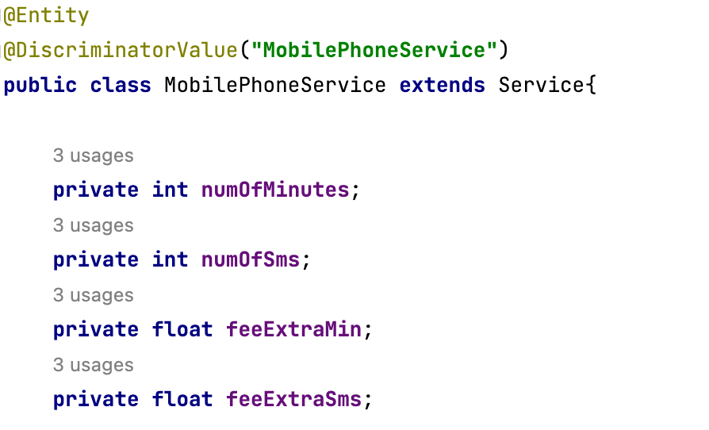
MobilePhoneService Entity

Slide 34
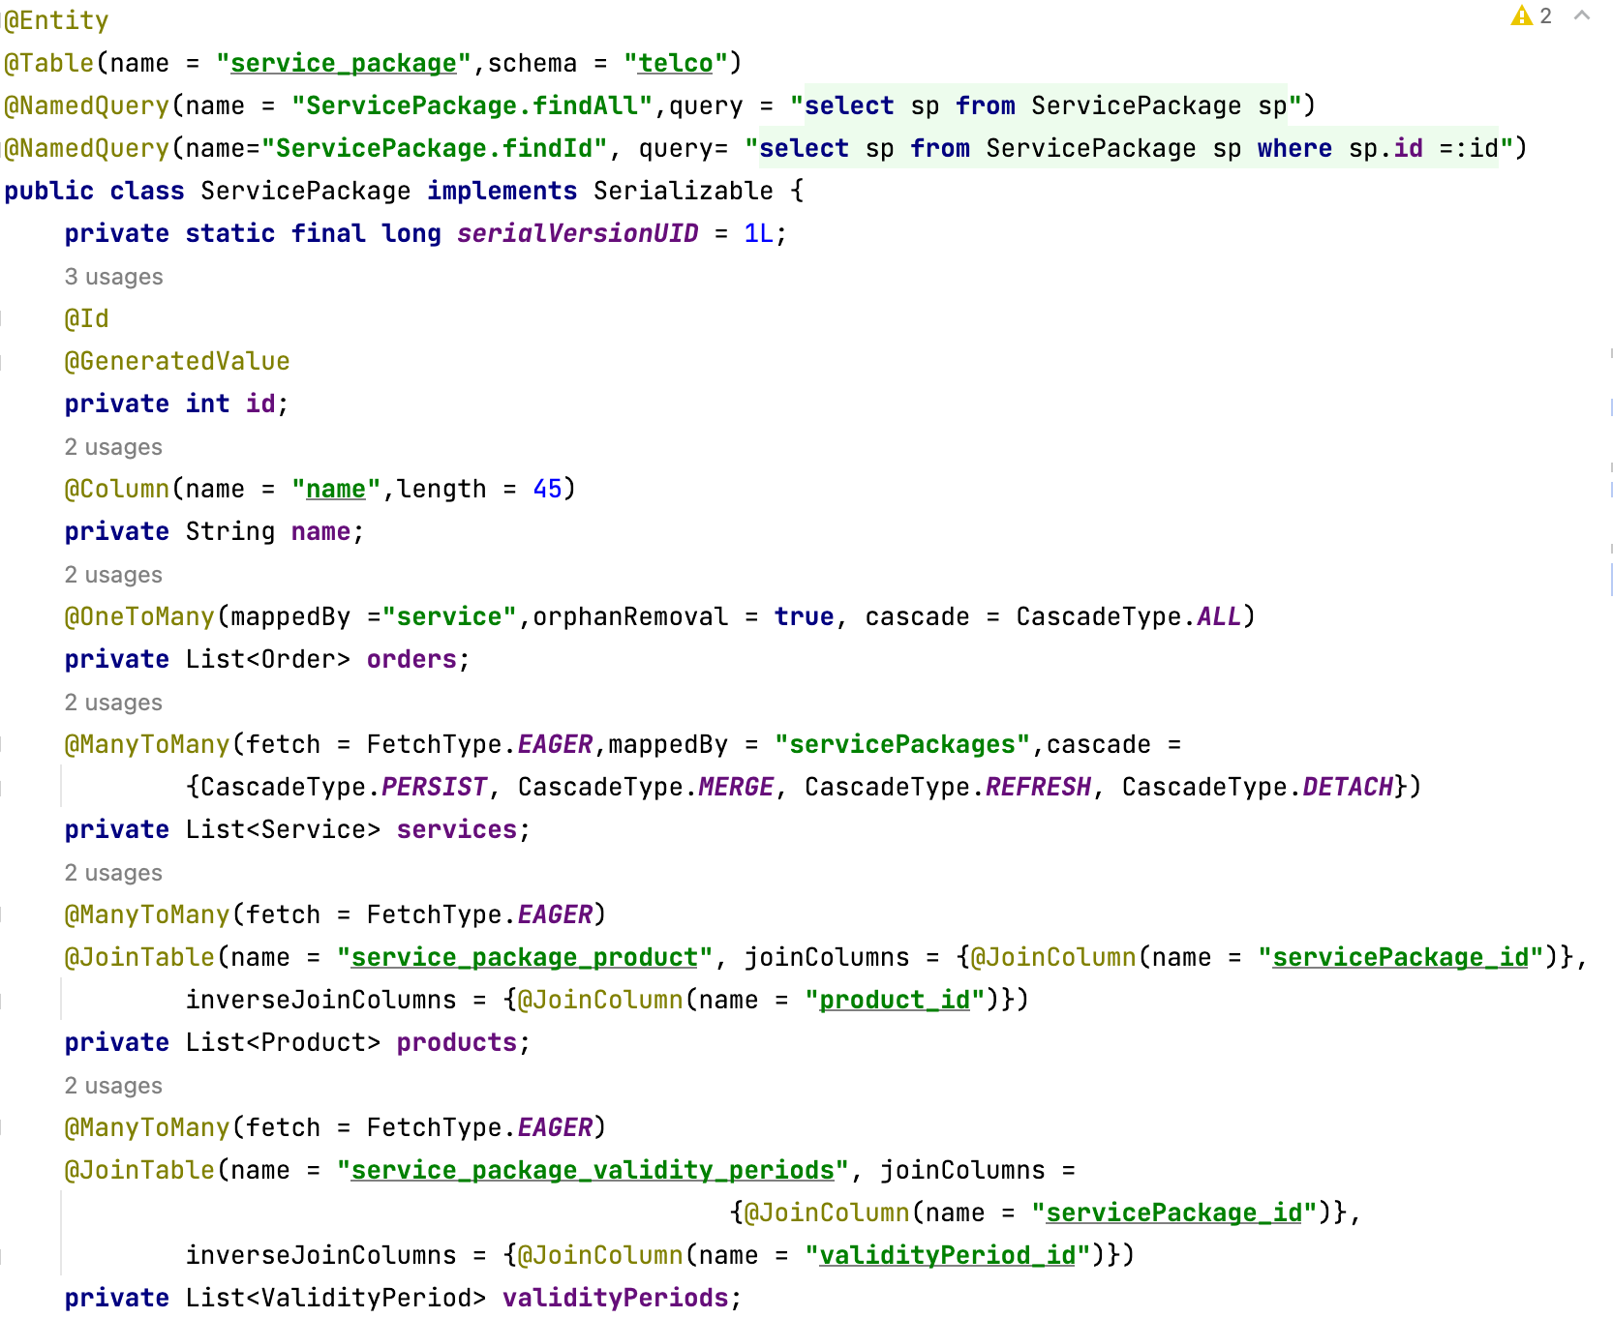
ServicePackage Entity

Slide 35
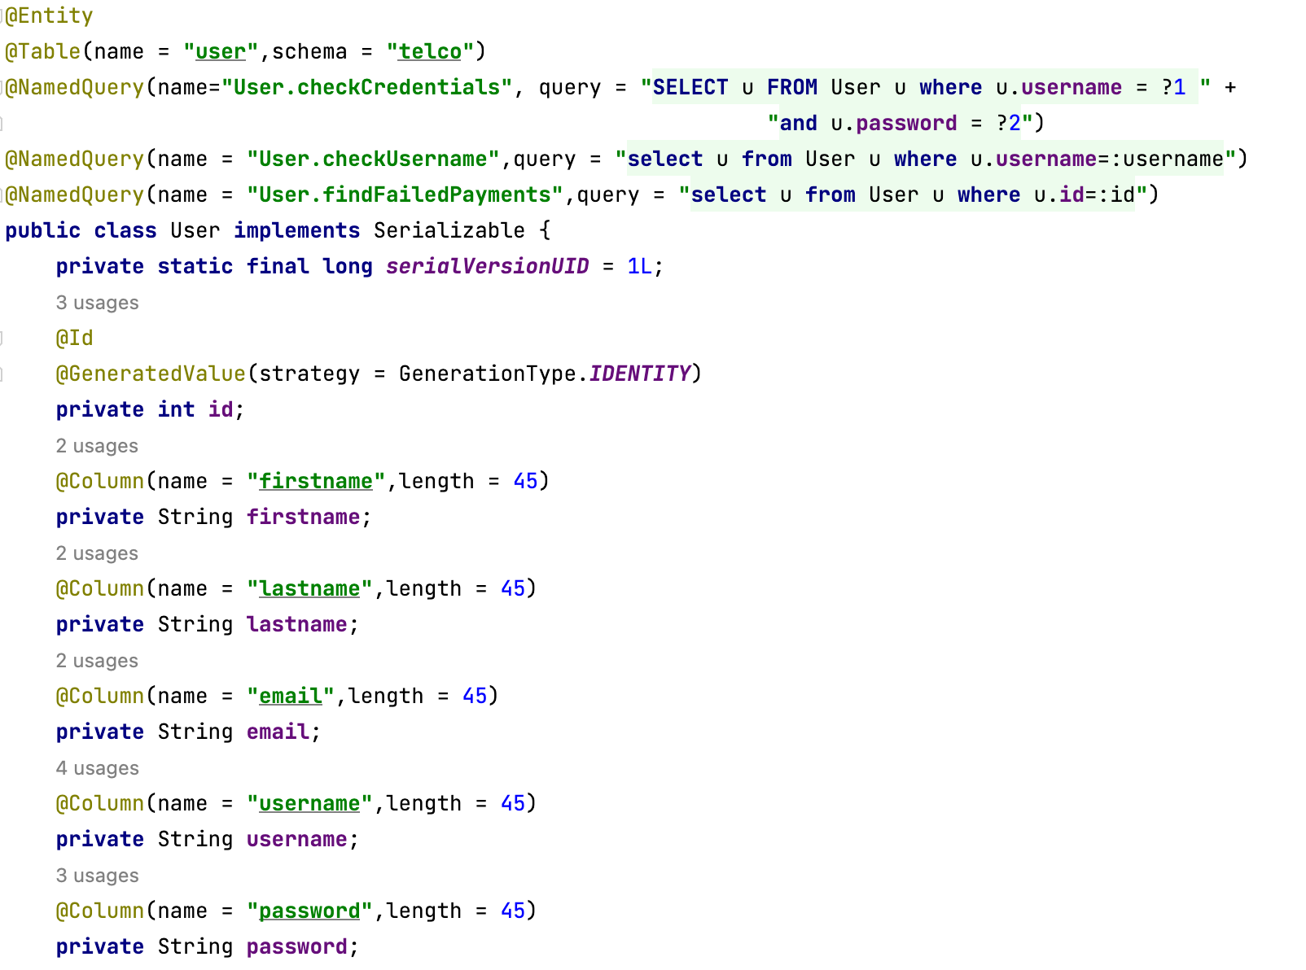
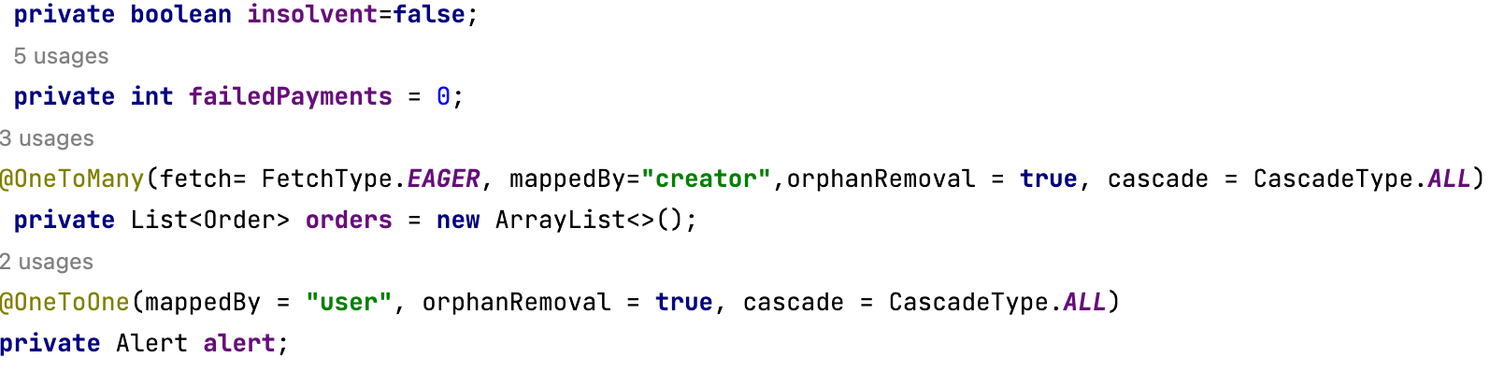
User Entity

Slide 36
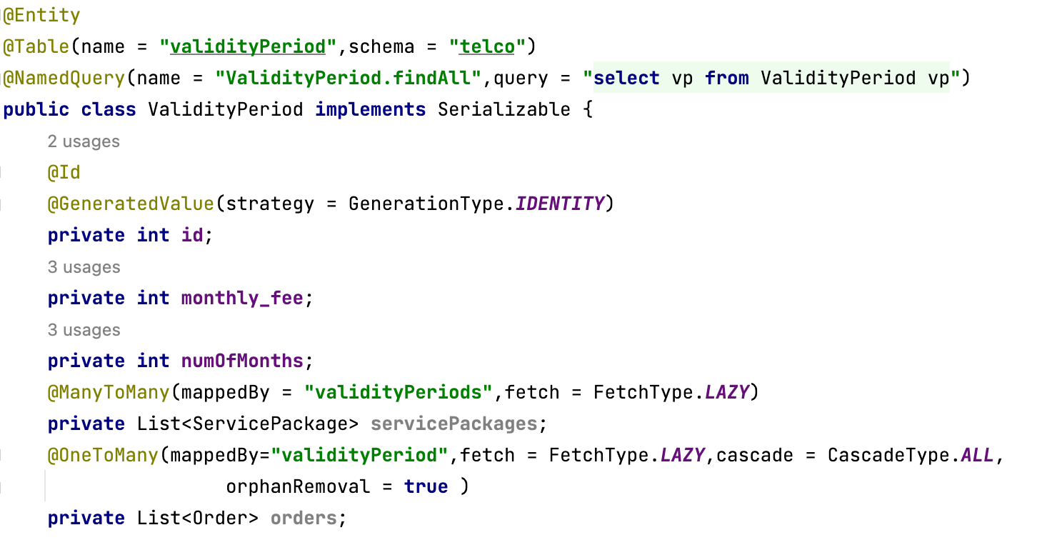
ValidityPeriod Entity

Slide 37
Functional analysis of the interaction
A web application allows the management of a telecommunication services provider both client and employee side.
CLIENT SIDE
After registering, the user is invited to log in (register and login page). After logging in, the user accesses a Home page, where there are two lists: the list of the user’s orders and the list of the available packages to buy.
An order belongs to a user, it has a package connected, the date of subscription start, end, the date of creation, products connected and a status (confirmed or rejected).
The list presents the orders in chronological order. On this list the user can click on the rejected orders package name to retry the payment.
This brings him to the confirmation page where he can see if the package has been bought or rejected again and all the other info about the order. From this page the user can return to their home page.
A package has a name, a list of connected services, a list of connected optional products, a list of possibile validity periods.
On the list of available packages on the home page the user can see all the info about a package and clicking on the name , they can see more in detail the prices of the correlated items(products, validity period, services) on the buy page and choose the parameters to create a new order with a form.
When he finishes to compile the form , he can click on the buy button and is redirected to the confirmation page.
The result of the payment changes the status of the order, if it goes trough, the order is confirmed, whereas if it is denied the order is rejected. This happens also when the user retries the payment: if it goes trough, the state of the order is changed from rejected to confirmed.
A user can also enter the homepage without logging in, trough the visit button, in this case the homepage will show only the available packages.
He can see the packages in detail and buy them, but the buy action will redirect them to the login page, since it is necessary to connect the package to a registered user.
EMPLOYEE SIDE
After registering, the employee is invited to log in (register and login page). After logging in they access an Homepage where there is a form to create a new package. On this page the employee can choose all the parameters of a package.
When finished he can create the new package with the create button, this will create the package and empty the form and permit the employee to create another package.
From the homepage the employee can access the report page where there are tables containing datas about the sales of the packages and their components.
Pages (views), view components, events, actions

Slide 38
Components
Client components
- Servlets:
Registration
CheckLogin
Visit
Homepage
ShowServicePackage
ConfirmationPage
CreateServicePackage
EmployeeHomePage
EmployeeReport
- Views:
Index
HomePage
ShowServicePackage
ConfirmationPage
EmployeeHomePage
EmployeeReport

Slide 39
Components
Back end components
- Entities:
employeeReport
AlertReport
AvgProductsPerPackage
BestProduct
InsolventUsers
SalesPackage
SuspendedOrders
TotalPurchasePackage
TotalPurchasePackageAndValidity
services
FixedInternetService
FixedPhoneService
MobileInternetService
MobilePhoneService
Service
Employee
Order
Product
ServicePackage
User
ValidityPeriod
- EJB:
UserBean
EmployeeBean
ServicePackageBean
OrderBean

Slide 40
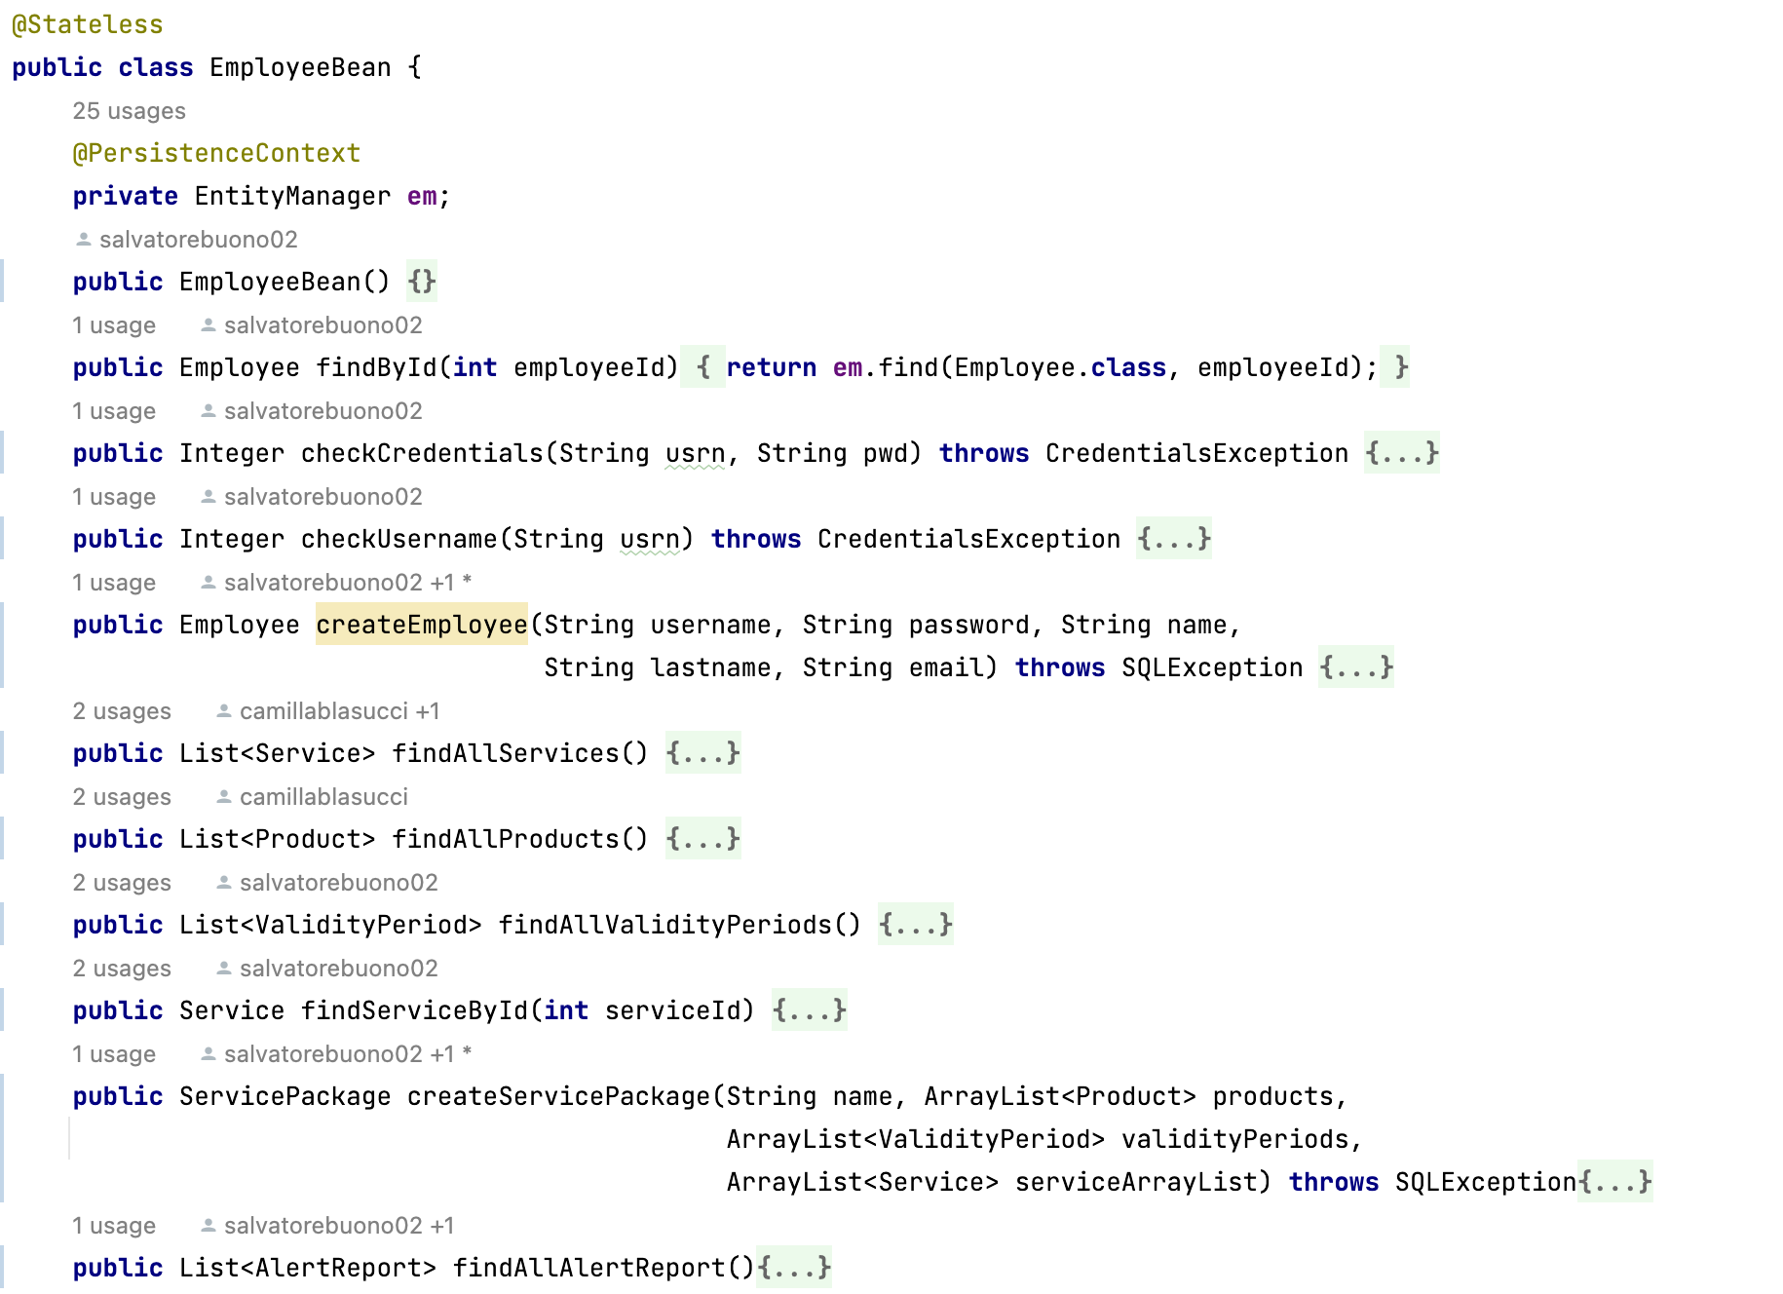
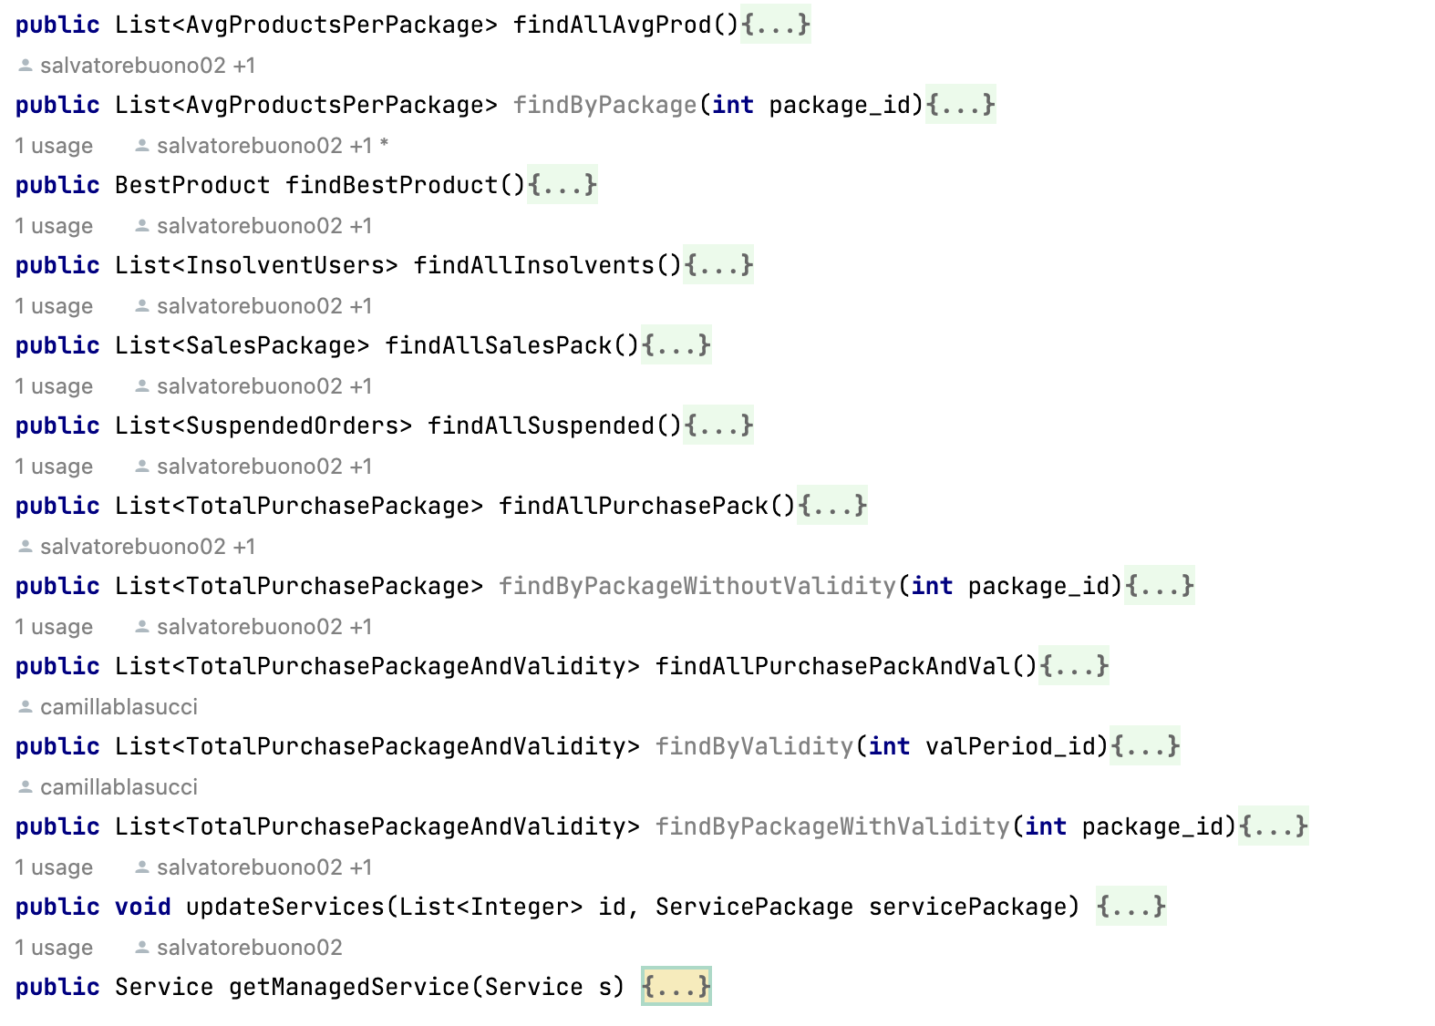
Components
EJB- Employee Bean

Slide 41
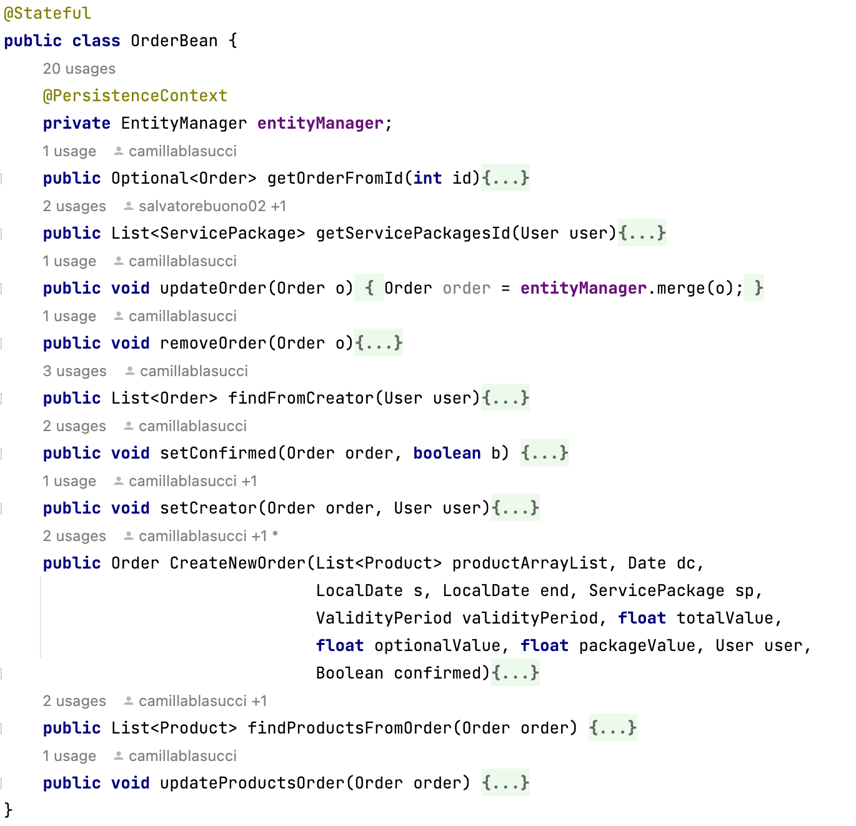
Components
EJB- Order Bean

Slide 42
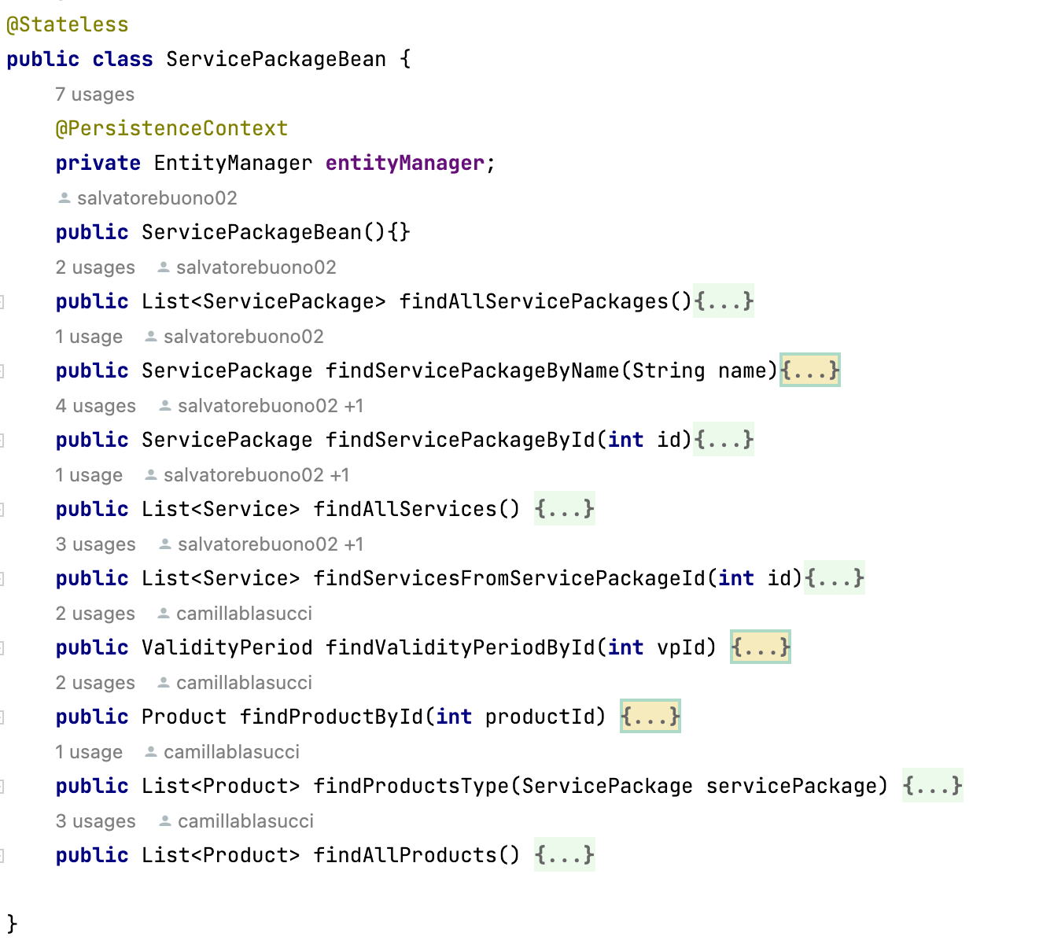
Components
EJB- ServicePackage Bean

Slide 43

Components
EJB- User Bean

Slide 44

UML sequence diagrams​
Beans are not designed for a better visibility

Slide 45


Slide 46


